Slide 1

Teesport Freeport Bid
by
Cllr Wayne Davies
(River Tees PHA and APHA Exec Board)

Slide 2

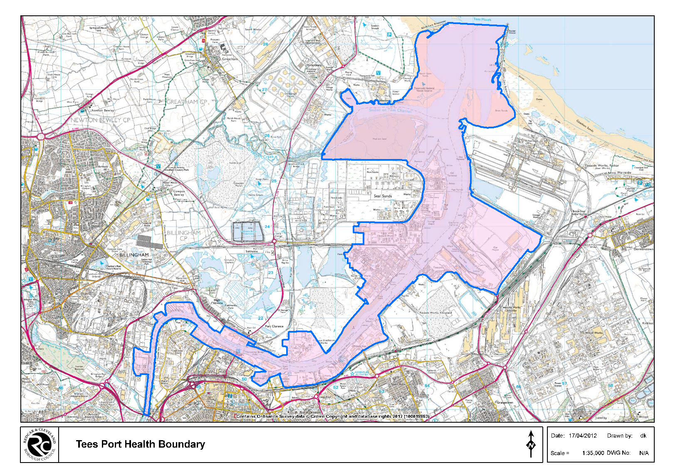
Jurisdiction

Slide 3

So what is a Freeport?
A freeport is an area which is physically inside a country but is considered to be outside it for customs purposes. That means firms can import goods into a freeport without paying the usual tariffs.
As a result, materials can be imported into an area, turned into products in a factory and exported again, all without paying customs fees.
It means global businesses are encouraged to use the freeport as part of their supply chain, creating jobs including in manufacturing.

Slide 4
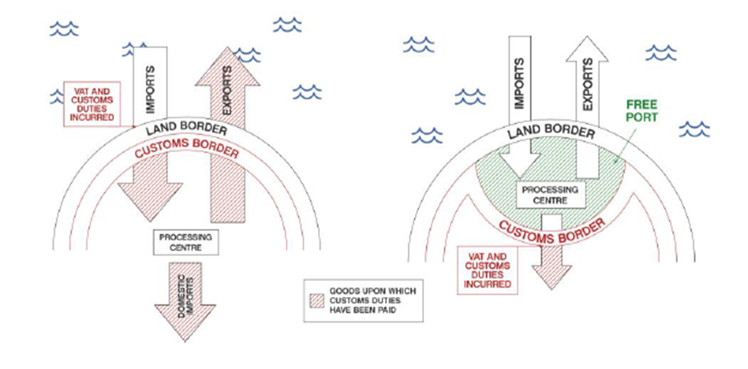
So what is a Freeport?

Slide 5
Economic Impact
Looking at creating seven free ports - Grimsby & Immingham, Hull, Liverpool, Manchester Airport, Hull, Teesport and Port of Tyne.
Even on conservative estimates, creating seven supercharged free ports across the North would promote a massive economic impact through increased trade, increased industrial activity and job creation.
Think tank Policy North has called for the creation of a freeport in the North East, and Tees Valley mayor Ben Houchen commissioned a report which concluded the proposal could create 25,000 jobs in the North East - 17,500 linked to Teesport and a further 8,500 jobs if the Port of Tyne was included.

Slide 6
Why now?
Parliament need to find a plan B for a ‘No Deal’ scenario or indeed ‘Canada+++(+++)’
British manufacturing jobs, particularly the car industry, rely on ‘frictionless’ trade between the UK and the EU
Simon Clarke MP (Middlesbrough South and East Cleveland) spoke on the issue in the House of Commons last week, here is what he said…

Slide 7
Customs Free Zone

Slide 8
Free Port Status
  There are approximately 3,500 Free Trade Zones worldwide, employing 66 million people across 135 countries.
  There are no Free Trade Zones on the UK mainland today
  Freeports have already been successful in countries such as the United Arab Emirates, where the Jebel Ali “free zone” in Dubai now hosts 7,000 global companies, employs 145,000 people and accounts for around 40% of the UAE’s total direct foreign investment.
Why can’t we create a Free Port?
As a member of the EU Single Market and Customs Union, the UK does not have control over its trade policy.
The UK is not able to set its own tariff/customs duties and administration.

Slide 9
How will they work?
The bigger and more complex, the more difficult to manage.
The smaller, the less impact they will deliver.
Airports/Seaports
Where will Port Health fit in?

Slide 10
Any Questions?

