Slide 1
Monitoring of imported food:
Food Water and Environmental Microbiology Services preparation for Brexit
Jim McLauchlin jim.mclauchlin@phe.gov.uk

Slide 2
FW&E Microbiology Services
Expert advice and access to laboratory services for food, dairy, environmental and water microbiology
National microbiological survey and surveillance data
Early recognition, notification, investigation and control of unusual events and outbreaks
Evidence base to inform the actions of PHE and others
Training of staff in the PHE and external partners
Applied R&D to support and progress all of the above
2
Notes:
2
2

Slide 3
Emerging or changing hazards:
Salmonella monitoring in imported chicken
 | Number of consignments |  |  |  |  |  | Number of samples
 | 2013 | 2014 | 2015 | 2016 | 2017 | 2018
Cooked | 32 | 29 | 31 | 50 | 261 | 64 | 2,268
Marinated | 2 | 0 | 1 | 11 | 2 | 0 | 80
Salted | 23 | 53 | 29 | 47 | 383 | 0 | 2,591
Raw | 14 | 9 | 7 | 13 | 101 | 92 | 1,165
NK | 10 | 2 | 2 | 8 | 0 | 0 | 180
Total | 81 | 93 | 70 | 129 | 747 | 156 | 6,284
Salmonella not detected in any cooked product

Slide 4
Salmonella in imported chicken
Salmonella detected in 106 (8%) of the 1276 consignments
 | Number of consignments (Salmonella Detected)
Year | 2013 | 2014 | 2015 | 2016 | 2017 | 2018
Brazil | 48(1) | 47 (2) | 14 (0) | 28 (1) | 667 (61) | 127 (6)
Thailand | 24 (0) | 27 (5) | 48 (5) | 96 (6) | 131 (16) | 25 (0)
Other | 9 (0) | 18 (0) | 9 (1) ¹ | 4 (0) | 17 (1) ² | 4 (1) ³
¹Israel, ²not stated, ³Chile

Slide 5
Serovars of Salmonella detected
 | Number of samples
 | Brazil | Thailand | Chile | Israel | NS
Total | 174 | 49 | 6 |  | 10
Salmonella Agona | 5 | 6
Salmonella Albany |  | 8 |  |  | 1
Salmonella Binza |  | 1
Salmonella Braenderup |  | 3 |  |  | 1
Salmonella Enteritidis | 1 | 12 |  |  | 3
Salmonella Give |  | 1 |  |  | 2
Salmonella Heidelberg | 139 |  |  |  | 1
Salmonella Hvittingfoss |  | 1
Salmonella Kedougou |  | 5
Salmonella Infantis | 1 |  | 6 | 4
Salmonella Mbandaka |  | 1 |  |  | 1
Salmonella Minnesota | 23 | 1
Salmonella Poona |  | 2
Salmonella Typhimurium |  | 4
Salmonella Virchow |  | 1
Salmonella Weltevreden |  | 2

Slide 6
Whole genome sequencing SNP typing
Results from 268 isolates, 220 with SNP addresses
Three <5 SNP clusters with human cases were detected:
• Salmonella Enteritidis, chicken from Thailand, 1 cases in 2016 associated with travel to Thailand
• Salmonella Infantis from Chile, 1 cases in 2017, no travel history
• Salmonella Virchow from Thailand, 3 cases in 2016, 2017, and 2018, 2 with travel to Thailand, one no travel history
Other associations between isolates from food and clinical cases detected at the 10, 25 and 50 SNP levels some of which were country specific. For example:
• 2 Salmonella Enteritidis clusters at 10 SNPs from chicken imported from Thailand all of which clustered with patient isolates at 10 SNPs with a travel history of returning from Thailand.

Slide 7
Core genome analysis of Salmonella serovars from imported chicken (EnteroBase World database)
 | Human cases | Food
Salmonella Agona (Thailand) | UK, Australia Canada
Salmonella Albany (Thailand) | UK | Fish (Thailand) Chicken (USA)
Salmonella Enteritidis (Thailand) | UK, USA, Ireland, Australia
Salmonella Heidelberg (Brazil) | UK | Chicken (Germany, Netherlands, Brazil)
Salmonella Infantis (Chiie) | UK, USA, Peru | Chicken (Peru)
Salmonella Minnesota (Brazil) | UK
Salmonella Typhimurium (Thailand) | Ireland | Chicken (USA)
Salmonella Weltevreden (Thailand) |  | Fish (China, S Korea, Vietnam) Invertebrate (Thailand)

Slide 8
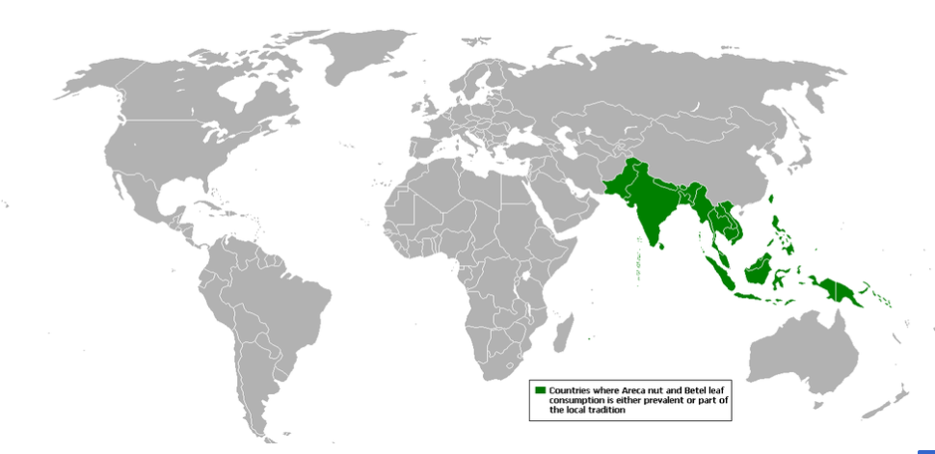
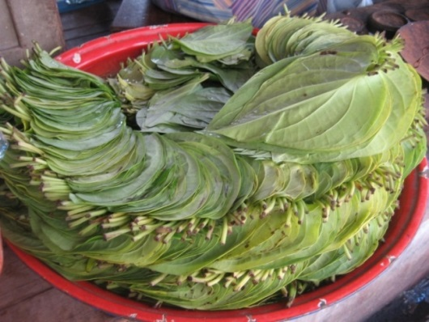
Betel leaves
Betel (paan/pan) leaves (Piper betle L.) traditional product that certain South-eastern Asian populations chew after meals
Imported into the EU particularly to UK and Germany but also to Italy, France, The Netherlands and Portugal

Slide 9
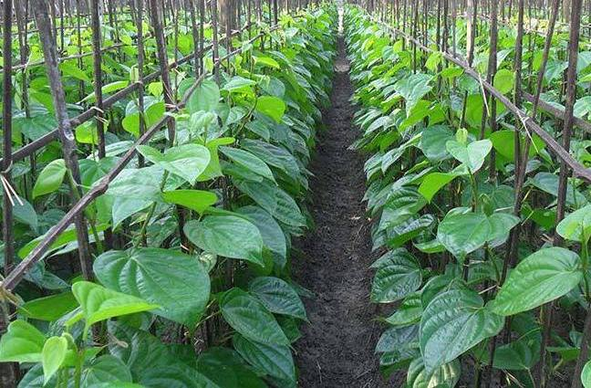
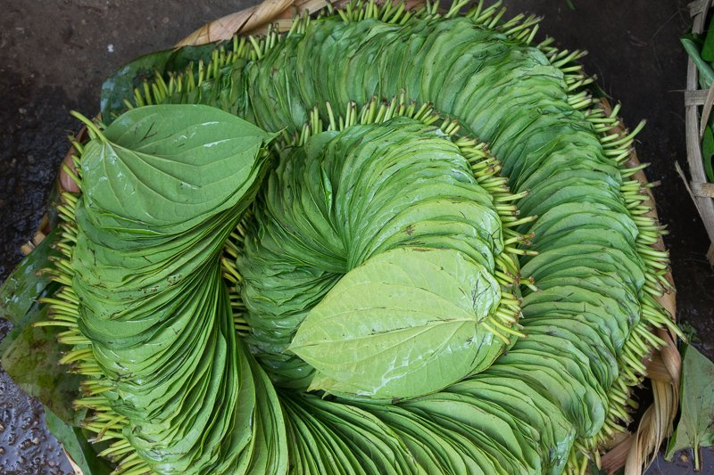
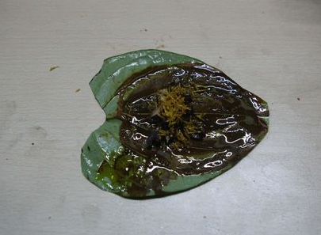
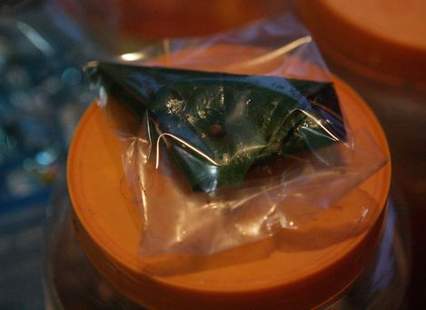
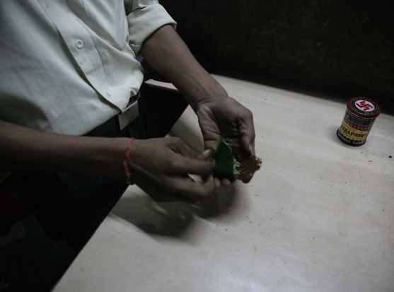

Slide 10
QMRA: Salmonella spp. contamination of betel leaves collected at Border Inspection Posts in four English airports
Year | Collected at Border Inspection Posts |  |  |  | Samples collected at retail, wholesale or catering
 | Number of samples |  | Number of consignments
 | Total | Salmonella spp. detected (%) | Total | Salmonella spp. detected (%) | Total | Salmonella spp. detected (%)
2011 | 539 | 198 (37%) | 108 | 83 (77%) | 67 | 17 (25%)
2012 | 515 | 120 (23%) | 103 | 62 (60%) | 0 | .
2013 | 481 | 78 (16%) | 97 | 42 (43%) | 11 | 1 (9%)
2014 | 145 | 16 (11%) | 24 | 8 (33%) | 42 | 1 (2%)
2015 | 116 | 24 (21%) | 19 | 9 (47%) | 22 | 3 (14%)
2016 | 78 | 19 (24%) | 21 | 10 (77%) | 1 | 0
2017 | 16 | 0 | 6 | 0 | 77 | 11 (14%)
Total | 1890 | 455 (24%) | 378 | 214 (57%) | 220 | 33 (15%)

Slide 11
Actions by Risk Managers
2011 after initial isolation of S.Augustenborg, FSA informed who issued RASFFs, discussions held between the EU Commission and the Bangladeshi and Indian High Commissions to ascertain what is being done to reduce contamination in the country of origin
2014 EU Commission implemented a temporary suspension of imported betel leaves originating or consigned by Bangladesh (Decision 2014/88/EU) which was extended in June 2015 (Commission Implementing Decision 2014/510/EU) and then to June 2018 and then to June 2020 (Commission Implementing Decision 2018/935).
2014 Betel leaves from India and Thailand were subjected to an increased level of official control at the designated point of (Commission Implementing Regulation (EU) 323/2014) and this continued for India in September 2015 (Commission Implementing Regulation (EU) 2015/1607).
2016 control of betel leaves from India was extended requiring that consignments be accompanied by results of sampling and analysis by the competent authorities in India for the absence of Salmonella (Commission Implementing Regulation (EU) 2016/166).

Slide 12
Actions by Risk Managers
Rapid Alert System for Food and Feed (RASFF)
2011-2017
More than 180 notifications
96% were from the UK

Slide 13
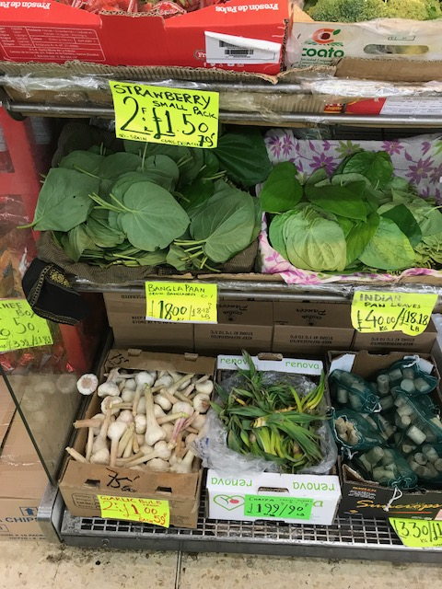
EU import prohibition for products from Bangladesh, but…
2017,
11 (14%) out of 77
sampled on retail sale
were from Bangladesh,
Salmonella detected in 4 (36%)
Bangladesh betel leaves on sale in London April 2018
13

Slide 14
Detection of Salmonella in replicate samples taken from consignments
No. of samples per consignment | Total | Number of 25g samples where Salmonella detected
 |  | 0 | 1 | 2 | 3 | 4 | 5 | 6 | 13
1 | 11 | 10 | 1
2 | 6 | 2 | 1 | 3
3 | 7 | 6 | 1 | 0 | 0
4 | 7 | 5 | 1 | 1 | 0 | 0
5 | 335 | 139 | 85 | 53 | 30 | 18 | 10
10 | 7 | 2 | 2 | 2 | 0 | 0 | 0 | 1
14 | 1 | 0 | 0 | 0 | 0 | 1 | 0 | 0
15 | 1 | 0 | 0 | 0 | 1 | 0 | 0 | 0 | 0
28 | 1 | 0 | 0 | 0 | 0 | 0 | 0 | 0 | 1

Slide 15
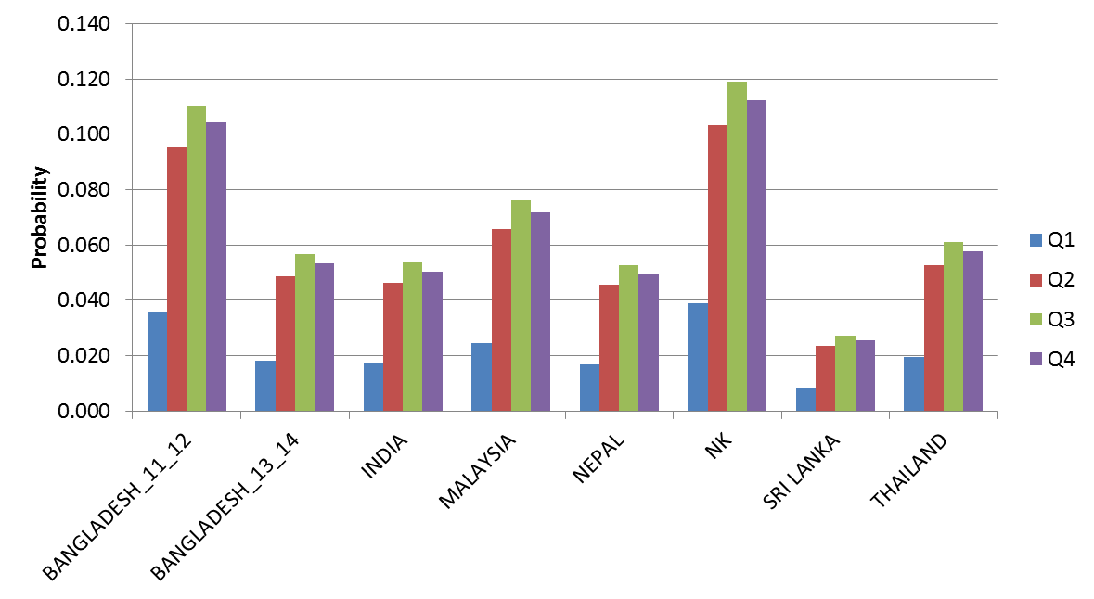
Using an MPN the estimated probability of a betel leaf having at least one Salmonella by quarter and country of origin

Slide 16

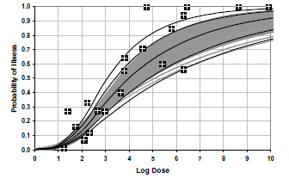
β-Poisson dose response model
Will you get infected!
Quantitative data on contamination of betel leaves used
Estimation used probability of contamination at retail

Slide 17
Estimated probability of illness to an individual by quarter and country using the dose response model
17

Slide 18
Using betel leaves from India
The probability of acquiring infection following a single exposure (serving comprised a single leaf) varied between:
quarter 1; 0.00003 (range 0.00002 to 0.00004)
quarter 3; 0.0001 (range 0.00007 to 0.00012)

Slide 19
Population estimate of number of infections
No direct consumption data available
Not possible to obtain
quantitative import data
However import data may be
problematic since:
Not all betel leaves eaten
also used for rituals and
decoration
Clandestine importation
occurs

Slide 20
Assessment of the population risk
Assumptions
consumption only occurred in individuals over 30 years of age
men more likely to consume betel leaves than women
serving constituted eating a single leaf
Two scenarios were modelled:
scenario 1, two servings per year for men and one per year for women;
scenario 2, 12 servings per year for men and six per year for women.

Slide 21
ONS Population data
British Asian Indian, Pakistani and Bangladeshi over 30 years of age in England in 2011
    718,509 men
    696,644 women
scenario 1, two servings per year for men and one per year for women
2.1 million servings per year
scenario 2, 12 servings per year for men and six per year for women
12.8 million servings per year

Slide 22
Population estimate of infection
scenario 1: 2.1 million servings per year
    160 cases per year (range 102 to 242)
    34 cases per year (range 22 to 51) reported to national surveillance
scenario 2: 12.8 million servings per year
    960 cases per year (range 612 to 1456)
    204 cases per year (range 130 to 310)
    reported to national surveillance

Slide 23
Two sporadic human cases
Patient 1. 74 year-old female of Asian origin
S.Bareilly (ST 203) isolated from the faeces in August 2015
S.Bareilly (ST 203) matched at the 0-SNP level to an isolate from betel leaves , country of origin not known
Sampled in June 2015 from a retail establishment from the same region <18 miles from patient’s home address
Patient 2. 44 year old male of East Asian origin
S.Newport (ST 31) isolated from the faeces in October 2017
S.Newport (ST 31) matched at the <5-SNP level to an isolate from betel leaves from Bangladesh
Betel leaves collected from retail sale in July 2017 from a different region to the patient’s home address

Slide 24
Characterisation Salmonella from Border Inspection Posts
Where multiple cultures from the same sample or consignment were characterised, only one representative isolate per serovar per consignment has been included
332 representative isolates
46 S.enterica subspecies I serovars identified,
plus un-named, Salmonella di arizonae, Salmonella salamae
      17% Salmonella Virchow
      10% Salmonella Java
      8% Salmonella enterica (un-named)
      7% Salmonella Brunei
      7% Salmonella Litchfield
      6% Salmonella Newport

Slide 25
Salmonella diversity within a consignment
214 consignments where Salmonella was detected in at least one of the replicate samples
      between one and 13 cultures submitted for characterisation per consignment.
119 consignments, 2 or more cultures were submitted,
      24 (21%) consignments the same serovar was identified on more than one occasion,
      95 (79%) consignments, between 2 and 8 different serovars (or species) were identified
  Amongst all 214 contaminated consignments, at least 95 (44%) had two or more Salmonella serovars (or species) present

Slide 26
Diversity within Salmonella serovars: S. Bareilly
Country | Setting | MLST | SNP | Relationship
India | Retail 2017 | 909 | not SNP'd
Not stated | Retail 2015 | 203 | 1.1.2.2.2.2.2 | Same sample <5 SNP to a case
 |  | 203 | 1.1.2.2.2.2.2
 |  | 203 | 1.1.2.2.2.2.2
Bangladesh | Retail 2017 | 203 | 1.1.2.110.111.114.118
Bangladesh | Retail 2017 | 203 | 1.1.2.113.114.117.121
Not Stated | BIP 2015 | 909 | 1.1.54.84.84.85.85 | Same consignment
 |  | 909 | 1.1.54.84.84.85.85
No close relationship between independent strains

Slide 27
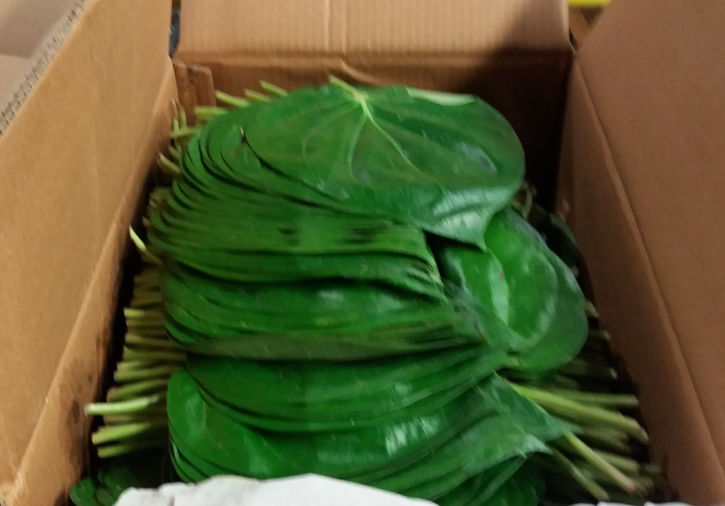
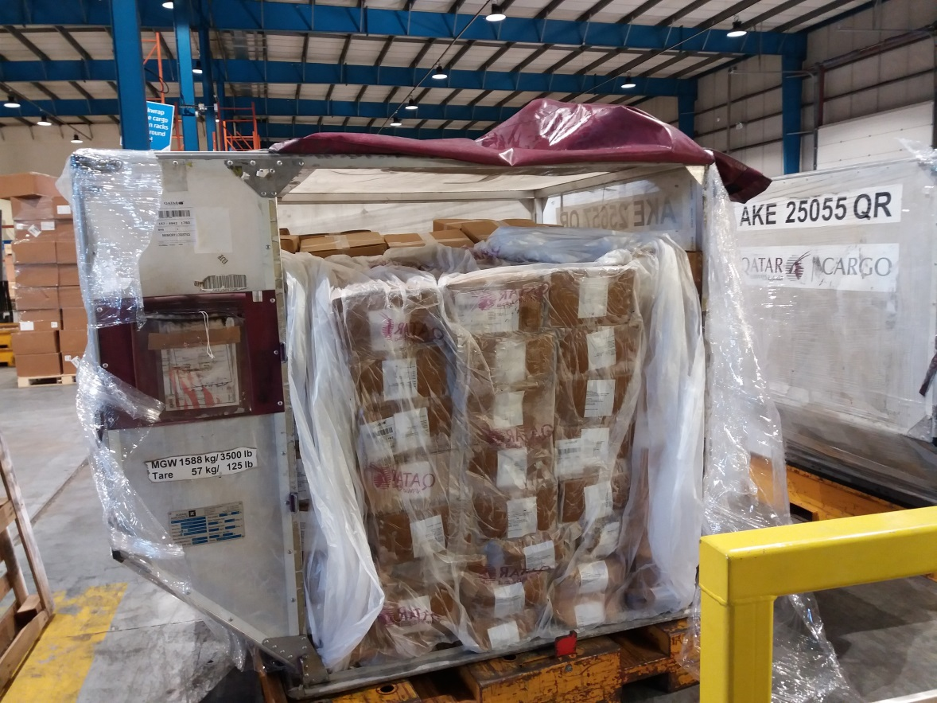
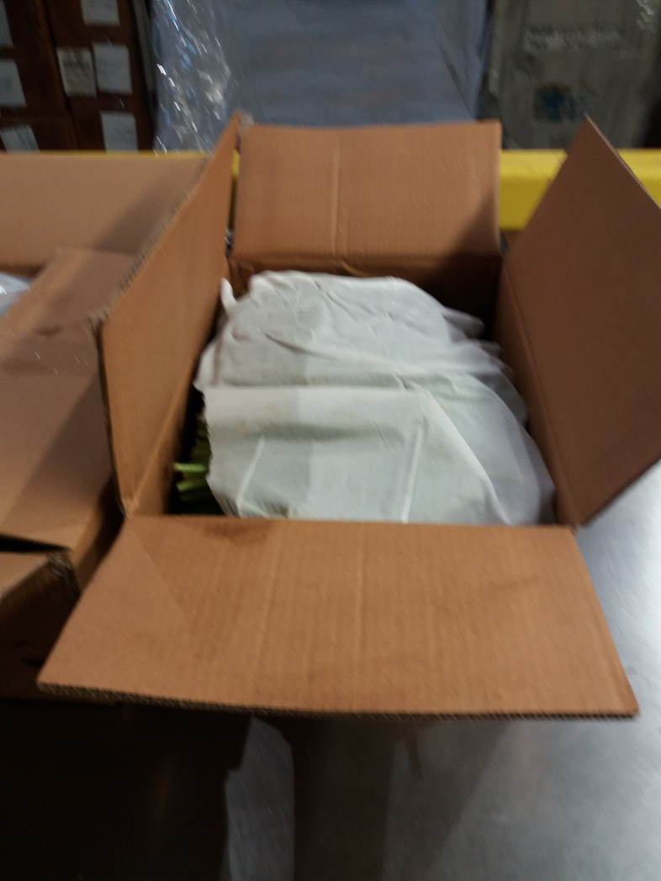
Consignment of betel leaves arriving at Birmingham International in 2018 at least 25,600,000 - 34,100,000 leaves/year enter UK
27

Slide 28
Assumption, each consignment contaminated with a different Salmonella
Worst case scenario (Q3), ~x3 pop estimate
Each consignment contains 82,000 leaves
0.2 chance of exposure to the same strain
Bangladesh (2011-12)
Probability of infection 0.0002
(upper confidence limit 0.00026)
Cases from one consignment 16
(21)
Cases reported to national
surveillance, 3 (5)
Cases recognised as infected with the same strain
<1 (1)
India
Probability of infection 0.0001
(upper confidence limit 0.00012)
Cases from one consignment 8
(10)
Cases reported to national
surveillance, 2 (2)
Cases recognised as infected with the same strain
<1 (<1)

Slide 29
Using an MPN the estimated probability of a betel leaf having at least one Salmonella by quarter and country of origin

Slide 30
Therefore………
It will be unlikely to identify more than one cases of salmonellosis due to the same Salmonella strain resulting from consumption of betel leaves from a single contaminated consignment
An exceedance generated from a surveillance system based on recognition of clusters of two or more cases associated with a common betel leaf consumption is unlikely to occur
There is a low probability of foods in general associated with transmission of disease being sampled independently of outbreak/incident investigations, although this has occurred in the past with other foods (e.g. S. Newport in watermelon in 2011)
Despite the high discriminatory power of WGS, the high heterogeneity of the Salmonella present in betel leaves, the probability of detecting a link with a Salmonella from a patient is very low

Slide 31
Population estimate of infection
scenario 2: 12.8 million betel leaf servings per year
    960 cases per year (range 612 to 1456)
    204 cases per year (range 130 to 310)
    reported to national surveillance
Predictions from this model that cases associated with betel leaf consumption will:
      occur in specific Asian ethnic groups
      be due to a very diverse group of Salmonella
      not occur in recognised outbreaks
      occur least often in Jan-March
      present as infections due to other enteric pathogens
      be ‘under the radar’ for current surveillance systems
31

Slide 32
Imported food data
important for surveillance
unique data-stream for public health
currently underutilized
important post Brexit
32

Slide 33
Its all team work!
33

