Slide 1

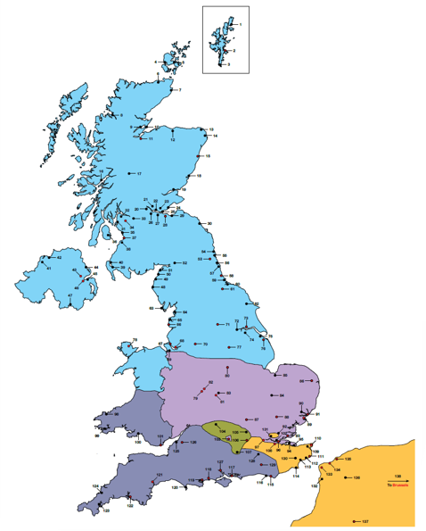
Border Delivery Group
Mark de Brunner
18 October 2018
Exit day: 23 weeks tomorrow

Slide 2
Border Delivery Group: role and strategic approach
Planning for an operable border at an aggregate level
Strategic lenses Sector-based groups
Infrastructure Aviation, Logistics
Communications Location-based groups
Member State controls inc Dover, ChT, Kent, other ports, PHAs, LAs, NI
Structured approach
Review of plans, including agreeing dependencies
Operating model assumptions, including transit volumes and processes
HMG requirements – general and RoRo
Comms plan requirements, including partnership pack
Location assessments
Supply-chain testing
Risks/issues logs

Slide 3
EU exit: implications for Port Health Authorities
Keeping change to a minimum. Risk-based approach to official controls. No change to risk day 1 from exit per se. So broadly no routine additional checks.
But will be some change to accommodate:
  replacing access to TRACES
  transits
  pre-notification
More information
  Technical notices, partnership pack
  TRACES replacement programme
  Port health steering group (includes PHAs, Defra, FSA)

Slide 4
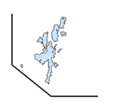
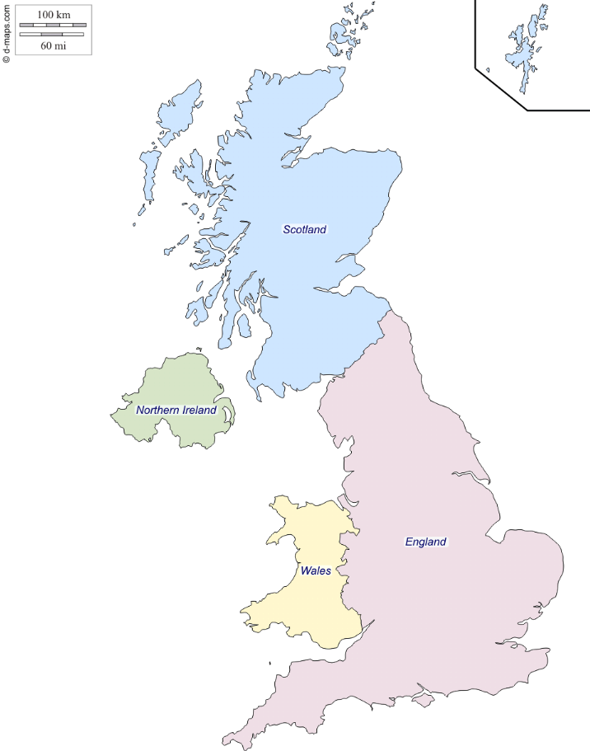
Border Delivery Group: location focus
BDG and BF have been engaging with 135 locations over the summer as part of the locations assessment project. Phase 2 starts tomorrow.
SCOTLAND – 37
PORTS (29)
Ayr | Buckie
Burntisland | Cairnryan
Dundee | Eyemouth
Finnart | Fraserburgh
Glasgow Docks | Glensanda
Grangemouth | Greenock Ocean Terminal
Hunterston | Invergordon
Inverkeithing | Inverness Port
Leith | Lochinver
Methil | Montrose
Nigg | Peterhead
Port Edgar | Rosyth
Scrabster | Stranraer
Stromness | Troon
Ullapool
AIRPORTS (8)
Aberdeen | Edinburgh
Glasgow | Inverness
Kirkwall | Prestwick
Sumburgh | Wick
ENGLAND & WALES
PORTS (45)
Avonmouth & Royal Portbury Docks | Barrow | Berwick-upon Tweed
Birkenhead | Blyth | Dover
Falmouth | Felixstowe | Fleetwood
Goole | Grimsby | Hartlepool
Harwich | Heysham | Hull
Immingham (ABP) | Immingham (C.Ro Ports) | Immingham (DFDS)
Ipswich | Isle of Grain (Thamesport) | Kings Lynn
Liverpool Docks | London Gateway | Maryport
Newhaven | North Shields | Plymouth
Poole | Portland | Portsmouth
Purfleet | Seaham | Sheerness
Shoreham | Silloth | Southampton Container
Southampton General | Sunderland | Teesport
Teignmouth | Tilbury | Tyne
Whitby | Whitehaven | Workington
AIRPORTS (33)
Biggin Hill | Birmingham | Blackpool
Bournemouth | Bristol | Cambridge
Carlisle | Coventry | Coverntry (Postal)
Doncaster Sheffield | Durham Tees Valley | East Midlands
Exeter | Farnborough | Gatwick
Heathrow | Humberside | Langley (Postal)
Leeds-Bradford | Liverpool John Lennon | London City
Luton | Lydd | Manchester
Newcastle | Newquay | Norwich
RAF Brize Norton | RAF Northolt | Shoreham
Southampton | Southend | Stansted
RAIL (4)
Ashford | Cheriton/Folkestone | Ebbsfleet
St. Pancras
NORTHERN IRELAND – 7
PORTS (4)
Belfast Harbour | Foyle Port
Port of Larne | Warrenport
AIRPORTS (3)
Belfast City | Belfast Intl.
City of Derry
WALES – 9
PORTS (8)
Barry Docks | Cardiff
Fishguard | Holyhead
Milford Haven | Newport Docks
Pembroke Docks | Swansea Docks
AIRPORTS (1)
Cardiff

