Slide 1
Food Fraud
A look at some new technology
Paul Hiscoe

Slide 2
Who is PH7?
We develop, implement and support IT innovation
Empowering field inspectors….
  To help improve consumer confidence in the food they eat
Paul Hiscoe
BSc Computer Science, University of Warwick
IT Management career
McDonnell Douglas
IBM
Sun
Pyramid
Sequent
Teradata ++
2005 Founded Transparencydata
Oliver Hiscoe
BSc Chemistry, Loughborough University

Slide 3

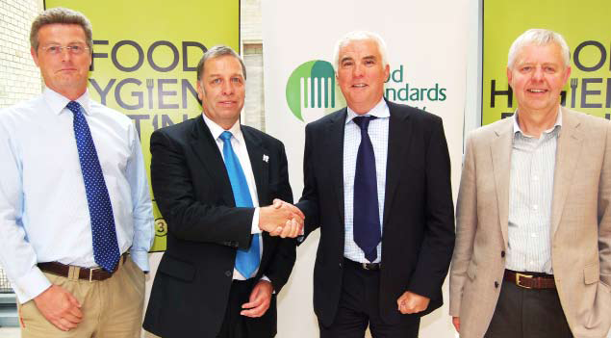
What have we done
Scores on the Doors
150 UK councils
FHRS is worlds largest food hygiene database
Performance management for leading UK Food Retailers
Scores on the Doors Australia
Notes:
Largest Food Hygiene database in the world. Improvements in compliance at over 50% of UK food businesses.

Slide 4
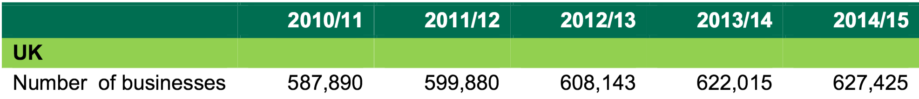
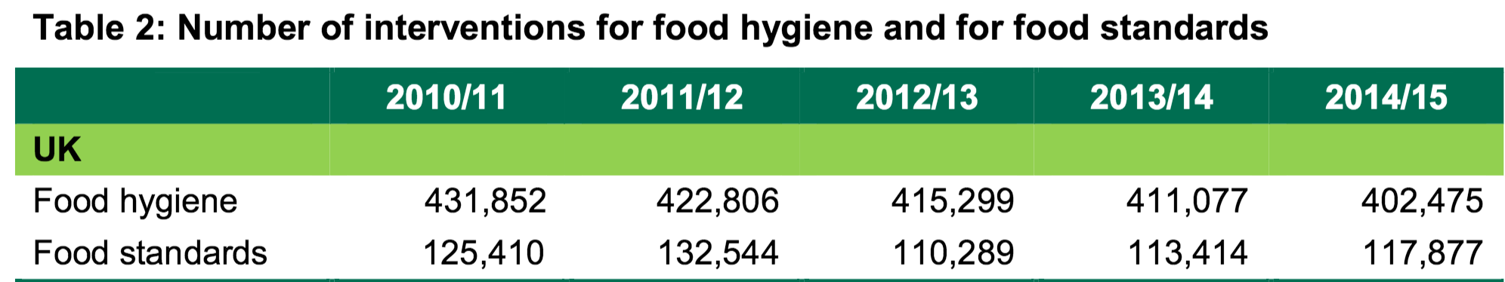
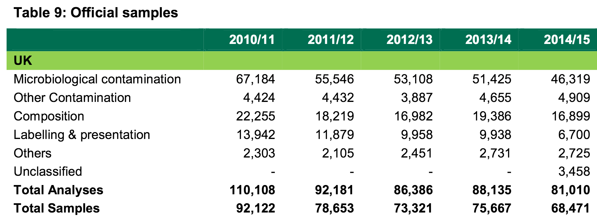
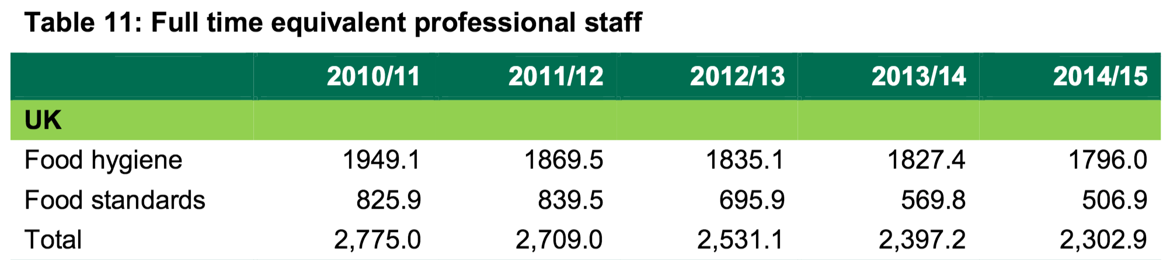
Current field trends
Number of registered businesses has increased by 6.7%
Food hygiene interventions have decreased by 6.8%
Total reported samples decreased by 25.7%
(exception was 2013/14 following the horsemeat incident)
Staff engaged in UK food law enforcement has decreased by 17.0%
*UK LOCAL AUTHORITY FOOD LAW ENFORCEMENT ANNUAL REPORT 2014/15. FSA 16/01/05 28 January 2016
Notes:
the number of food businesses and customer complaints continue to rise, while local authority staff resources, intervention and sampling levels continue to fall

Slide 5
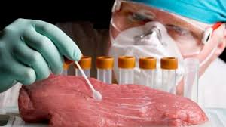
Lab testing statistics
Typical cost per sample £100 - £400
Verification rate 6% - 30%

Slide 6
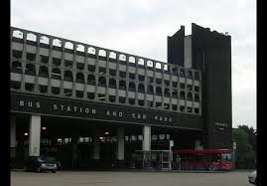

A new approach

Slide 7

One of the major areas ripe for development is “fingerprinting” of food in the field, he says, predicting that this technology will be in field tests in the United Kingdom within two to three years. Instead of using mass spectrometry techniques to identify a particular trait—such as the presence of an illegal dye—fingerprinting looks at the entire molecular composition of a foodstuff. That makeup is influenced by a host of factors including the climate, the acidity of local rain and the soil type, and will vary according to where a plant or animal was grown.
Unlike conventional mass spectrometry, fingerprinting is non-invasive. Using a Near InfraRed (NIR) scanner, which works by exciting the molecules in the sample and then measuring their reaction, an inspector should be able to scan a sample of grain in a warehouse, download the results to a tablet and then compare the data with a central library before coming back with a match.
Professor Chris Elliott
18 March 2015
http://futurefood2050.com/arresting-food-fraud/

Slide 8
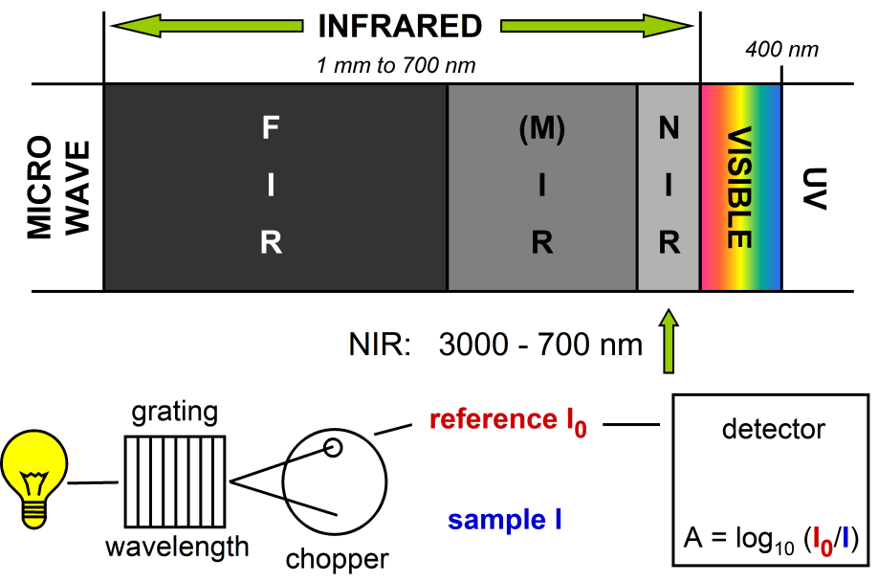
William Herschel 1738 - 1822
Discovered NIR spectrum AD1800
NIR Spectroscopy widely used in labs for molecular analysis starting 1950’s
Notes:
The old Slough bus station is probably better known from the opening scenes from the BBC comedy programme “The Office”. However the new bus station, opened in 2012 is a memorial to one of the best-loved residents who lived for many years in the town. The wave forms of the roof reflect those characteristic of the spectra generated when analysing materials using Herschel’s discovery.

Slide 9
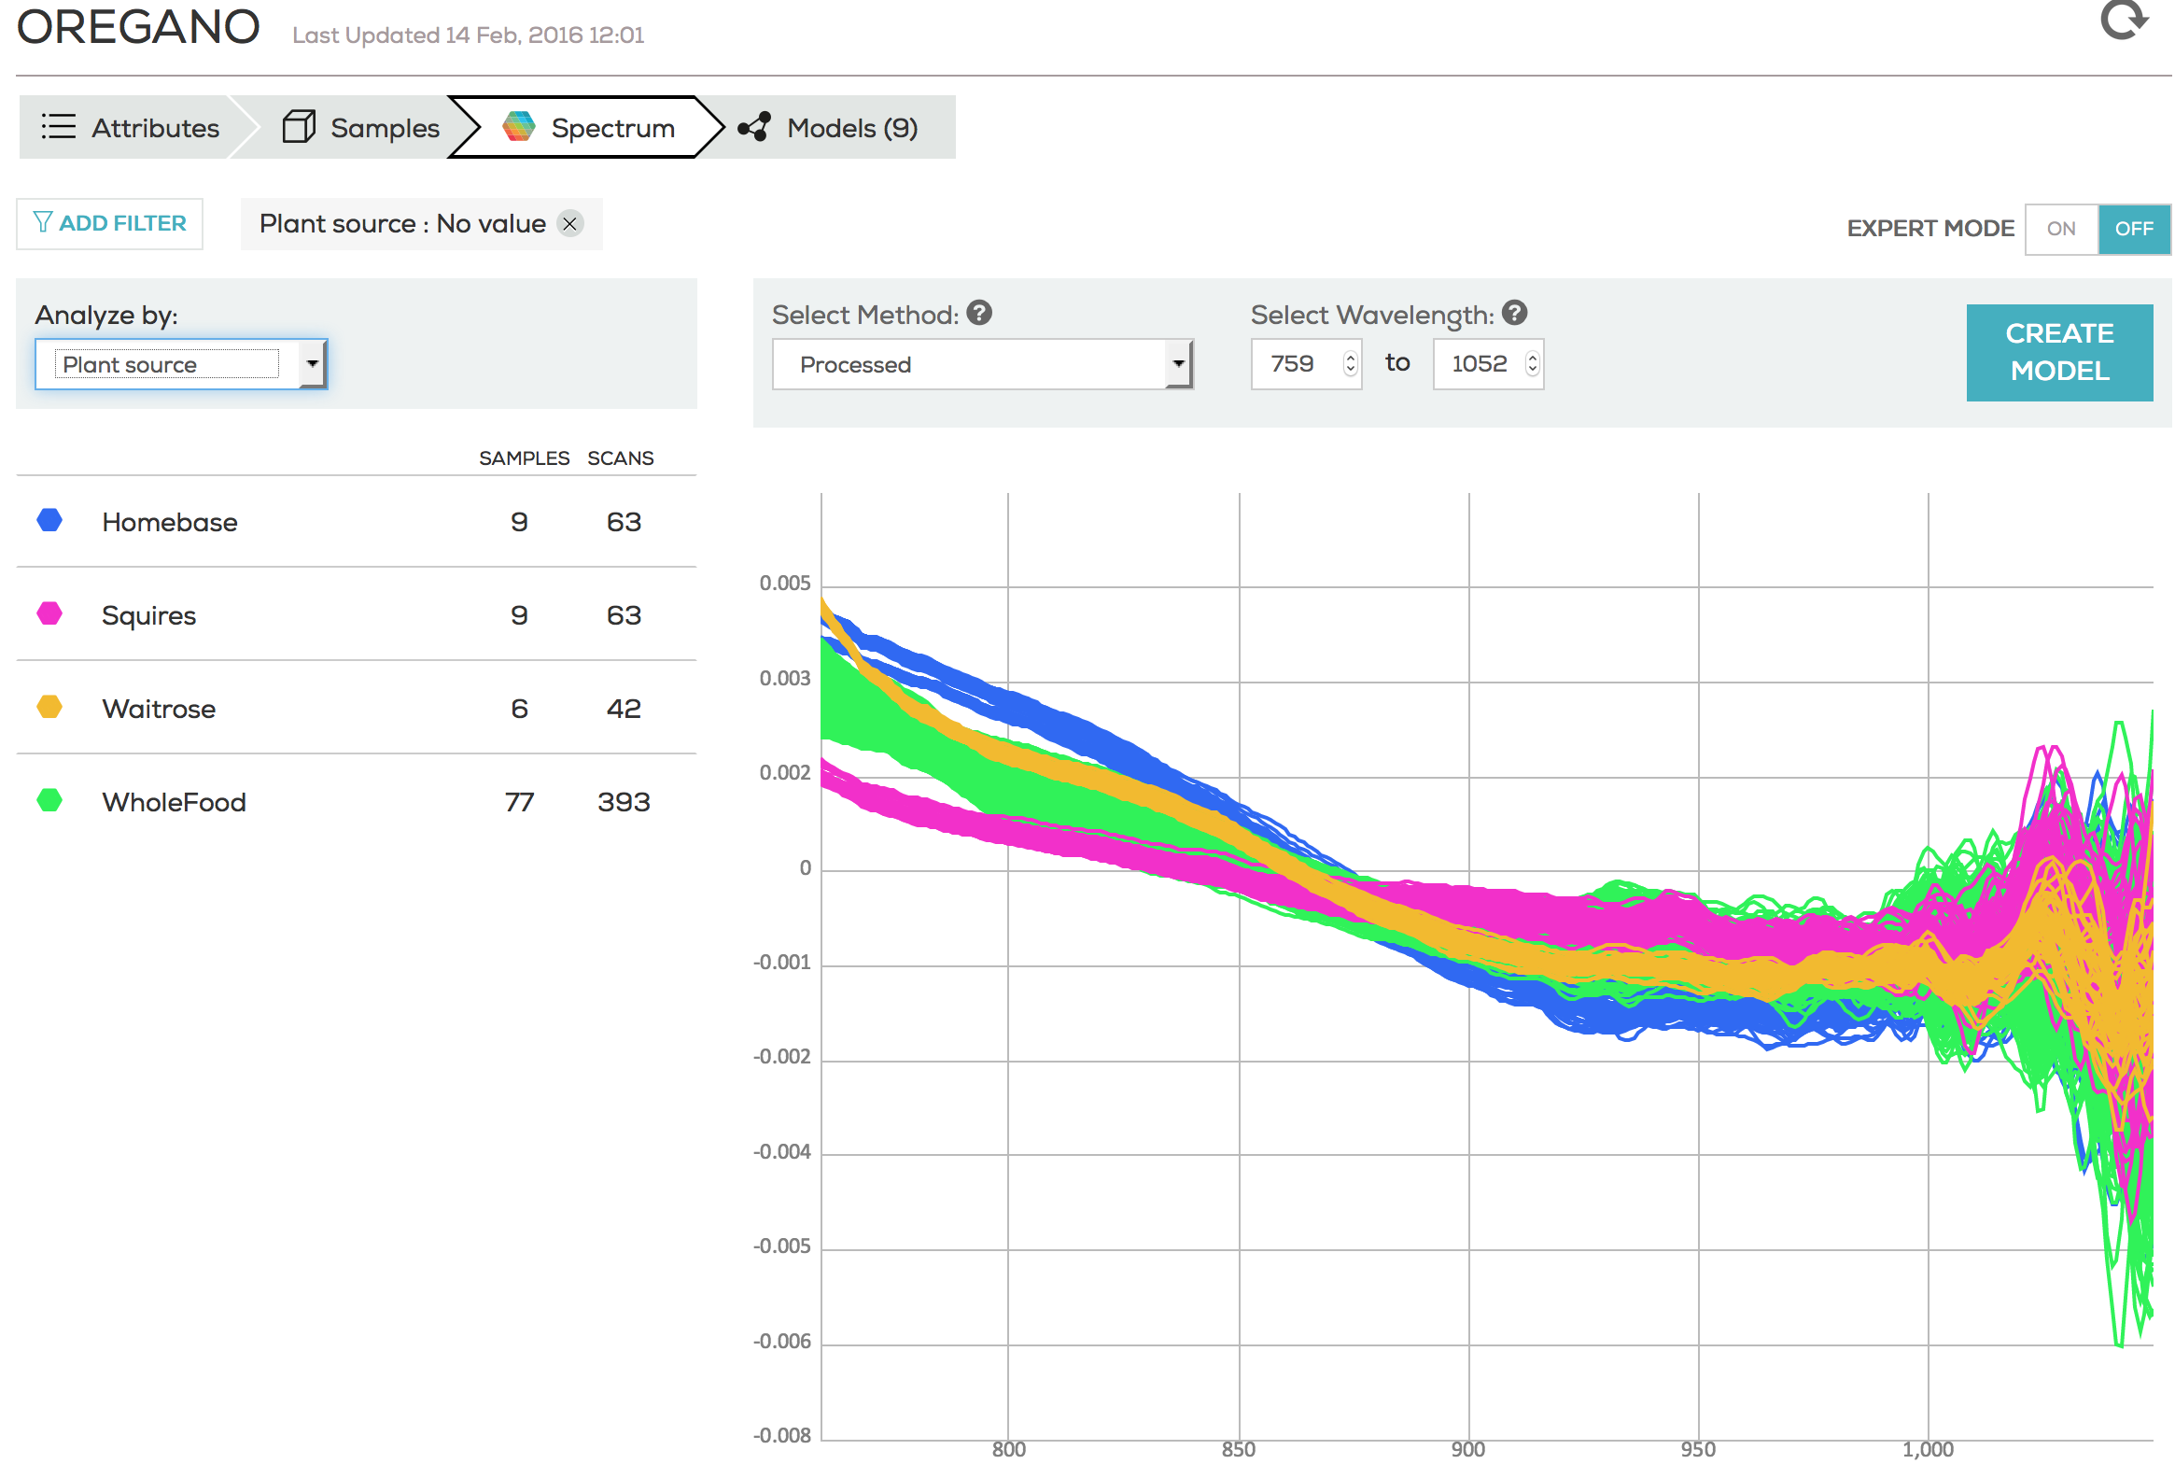

Near Infra Red Spectroscopy

Slide 10
Some applications of NIR
Crops
  Forage
  Fecal nitrogen
  Fecal Phosphorus
  Wheat
  Corn
  Fruit
  Nuts
  Sugar
  Rice
  Barley
  Leaf
  Herbs
  Spices
Oils
  Cooking Oil
  Olive Oil
  Palm Oil
Soils
  Minerlisation
  Moisture
Liquids
  Alcohol
  Bacteria
Pharmacutical
  Target blends
  Counterfeit detection
  Supplements
  DNP
  DMAA
  Melamine
Health
  Tissue oxygenation
  Neuroimaging

Slide 11
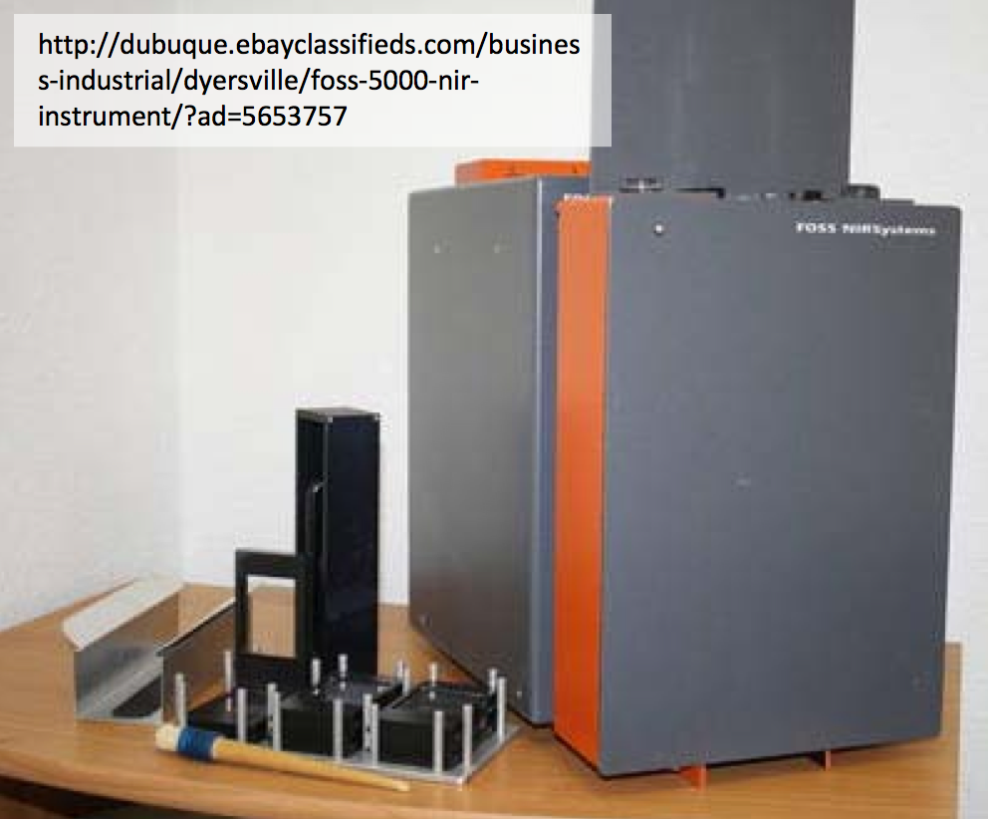
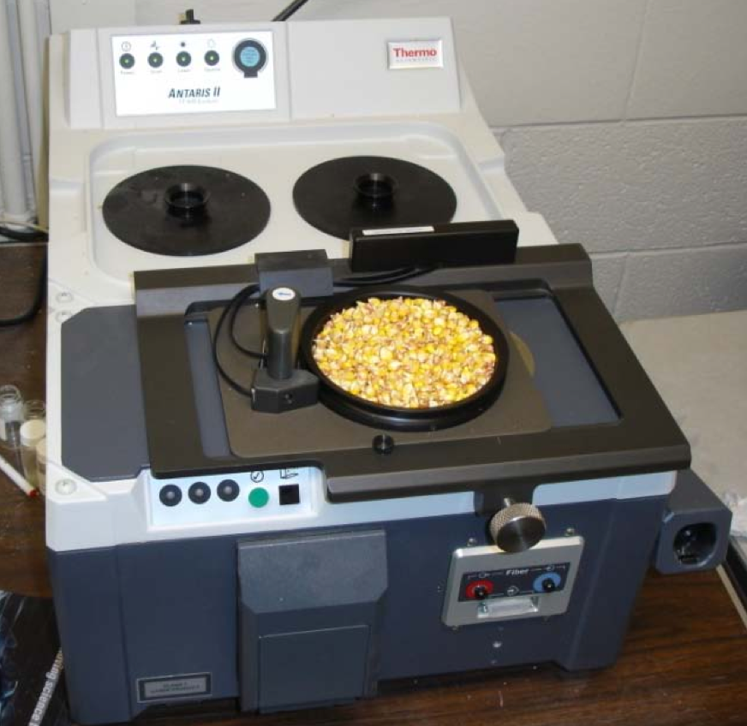
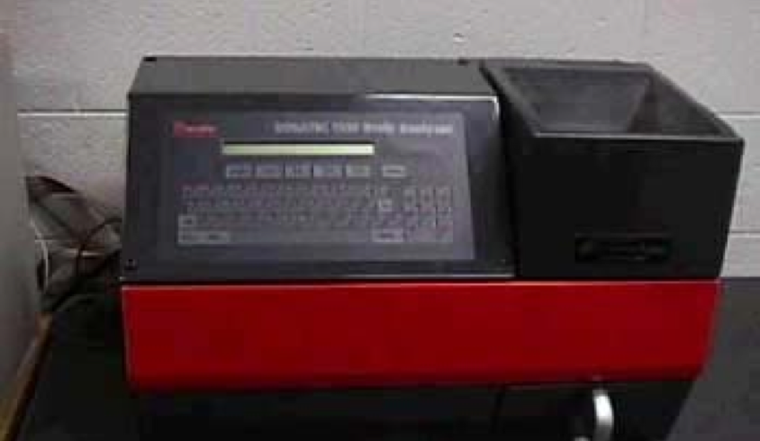
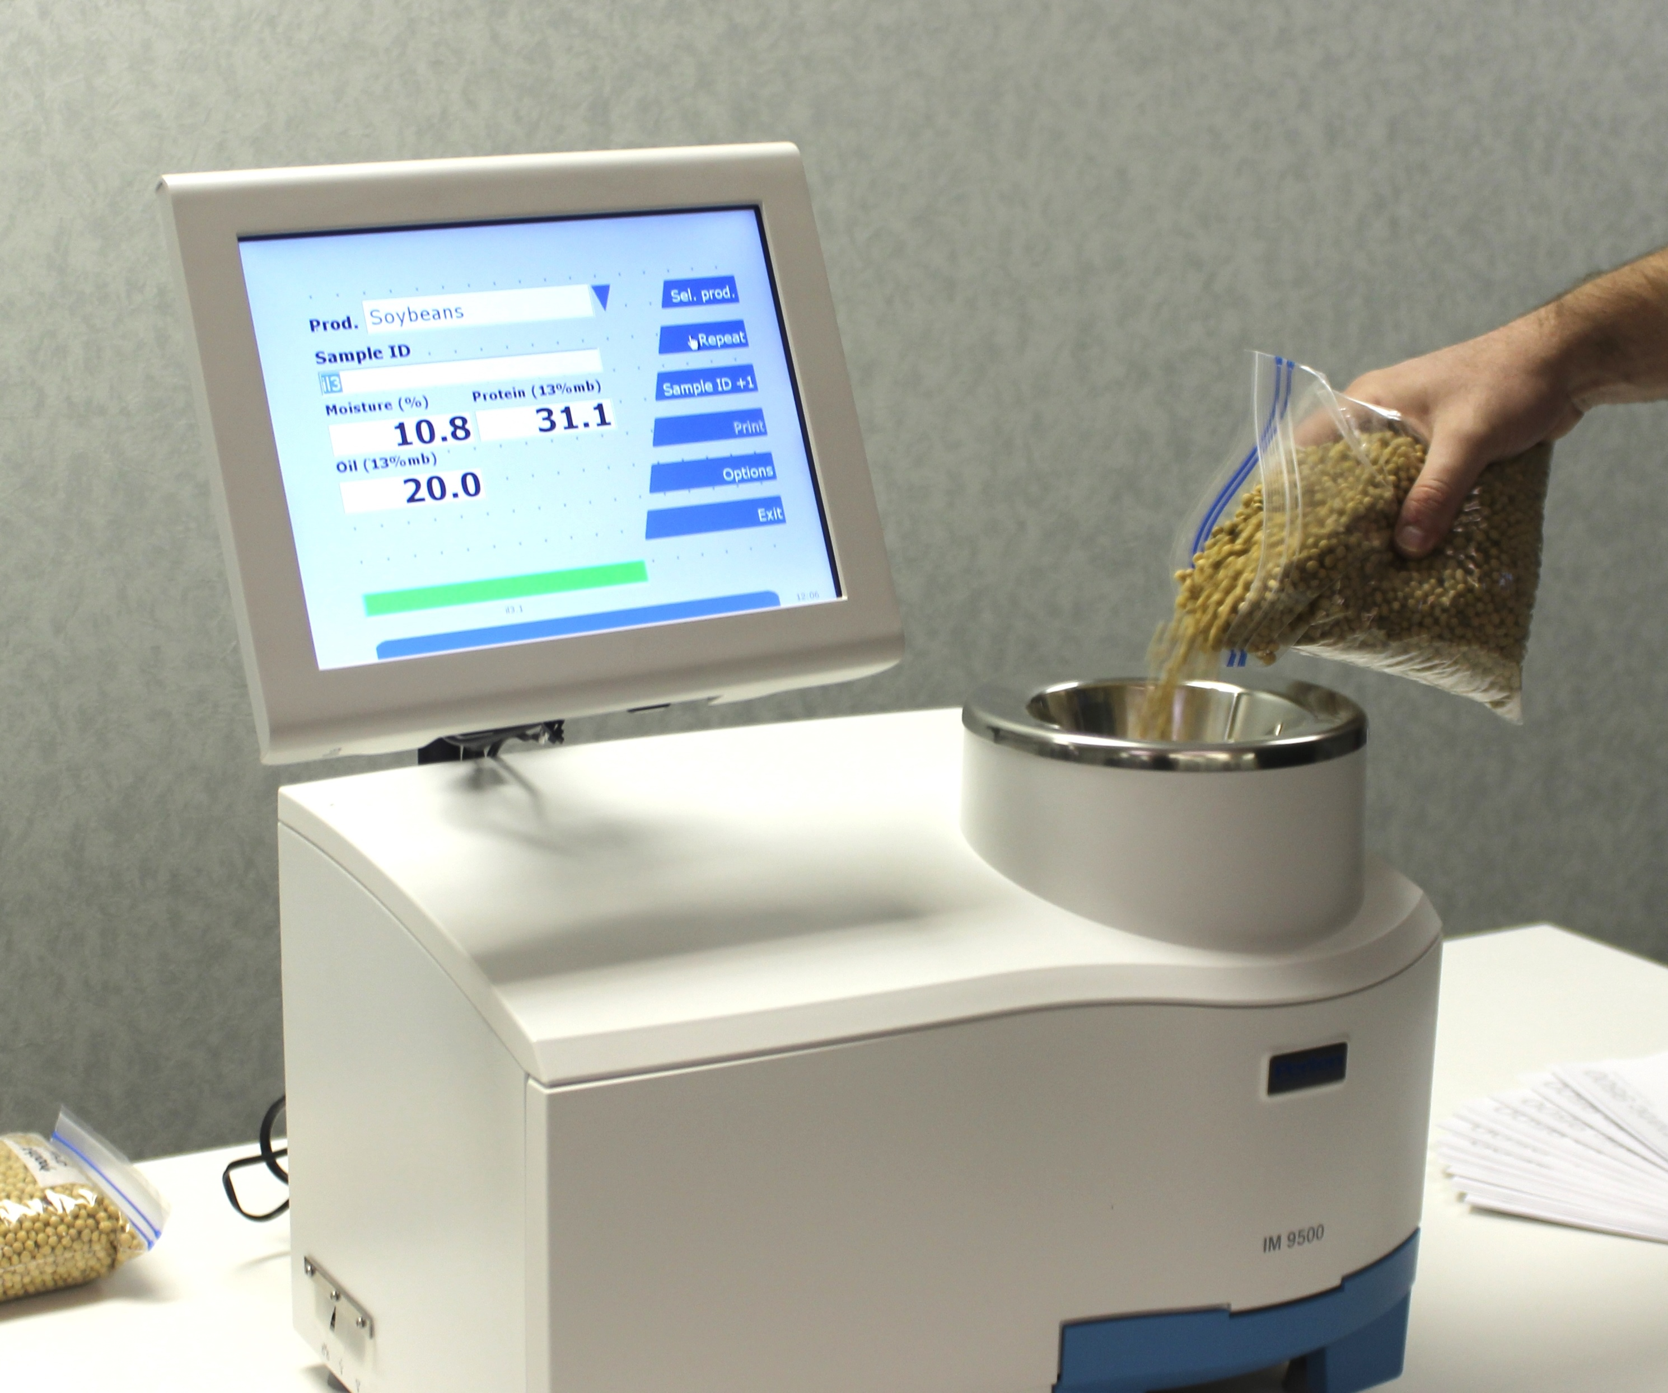
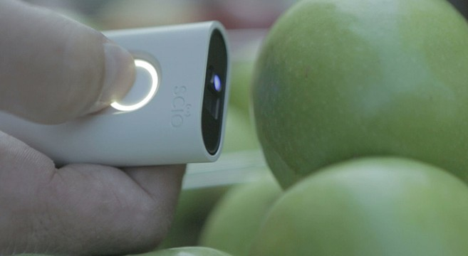
December 2015 – First handheld NIR scanner ships
$30,000
$50,000
$80,000
$23,000
$250
Notes:
Who has heard of NIR?

Slide 12
Advantages
No consumables
Non-destructive
Non –invasive
Small sample size
Instantaneous measurement
Minimal sample preparation
Penetrates far into samples
Pure compounds positively identified (Non-targeted analysis)
Disadvantages
Cannot detect < 1% contaminants
Calibration less accurate than wet chemistry
Narrow band
Cannot detect heavy metals, salts, non-organic contaminants
Capable of screening for:
Detection of C- OH NH molecules
Brand authentication
Adulteration detection (ppm)
Nutritional content
Not Capable of screening:
DNA sequencing
Contaminants (ppb)
Microbiology
Notes:
So I bought one and built a model

Slide 13
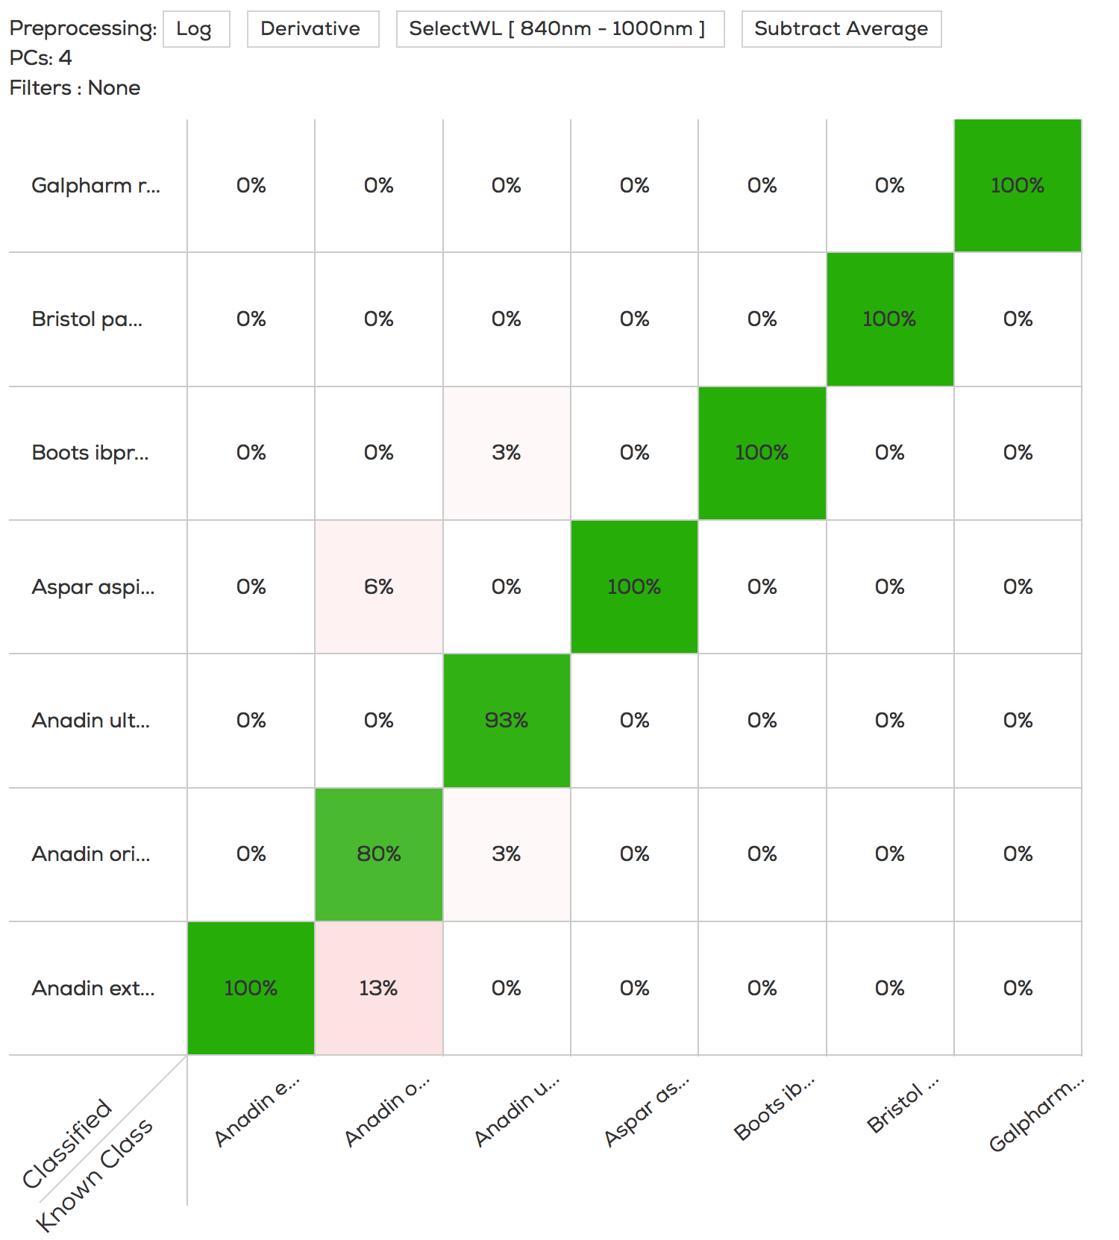
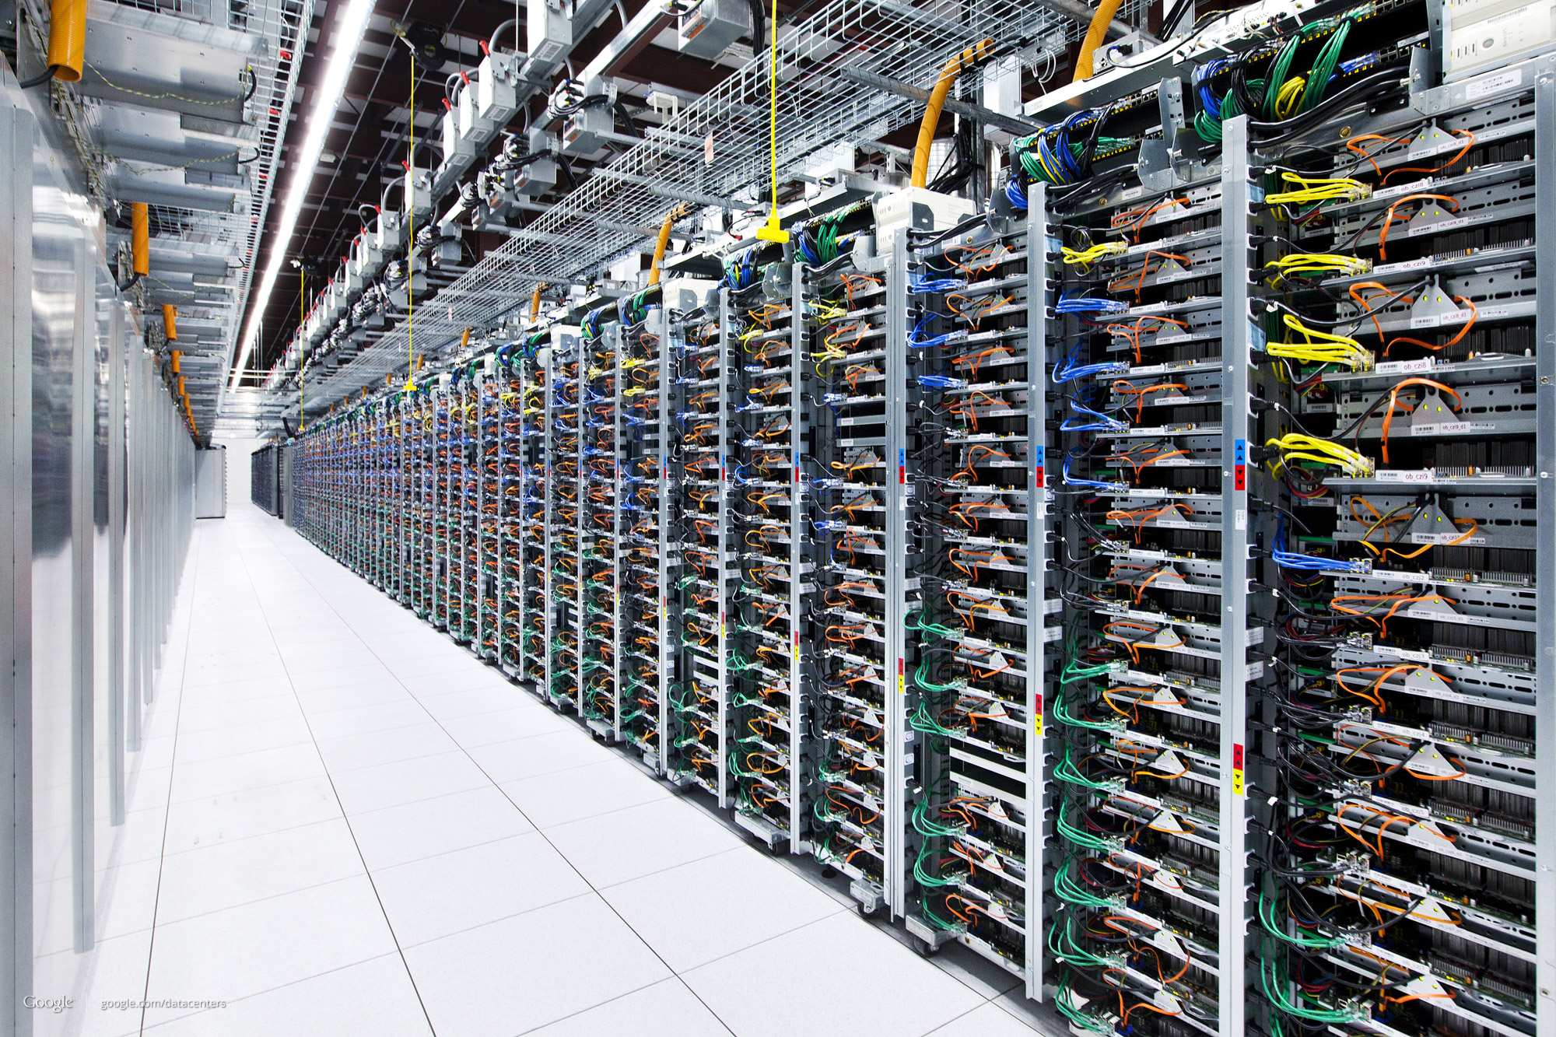

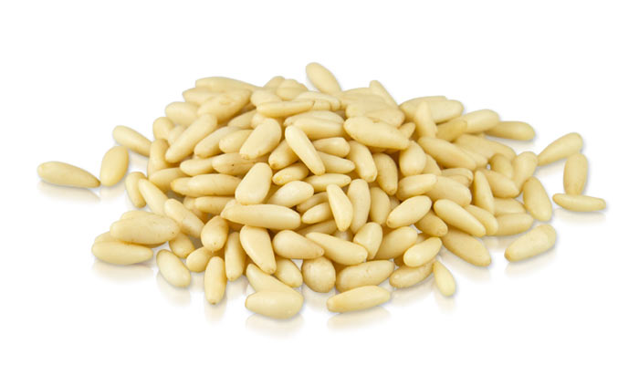





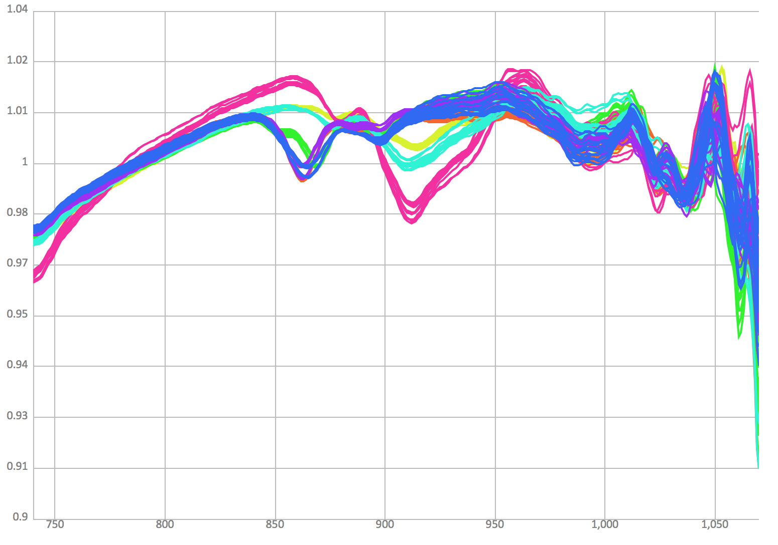
How does it work
Models
Spectral Analysis
FoodScan
Pinus Armandii

Slide 14
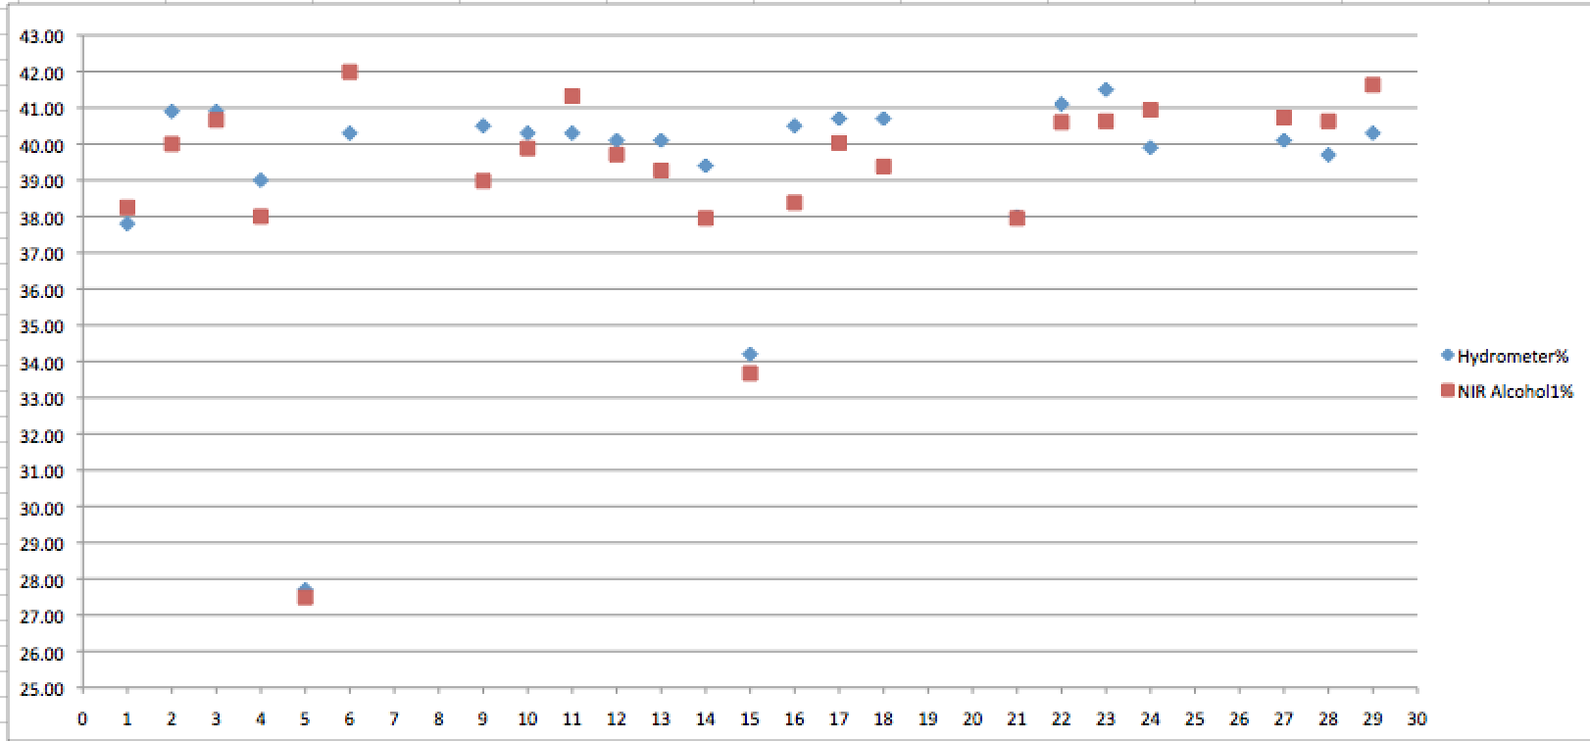
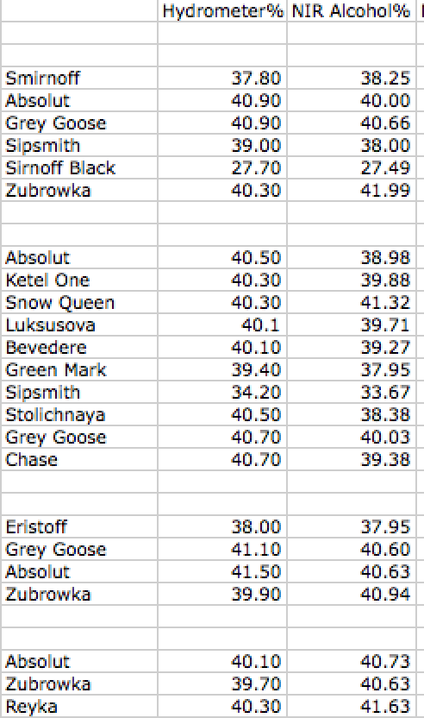
Recent field test 1

Slide 15
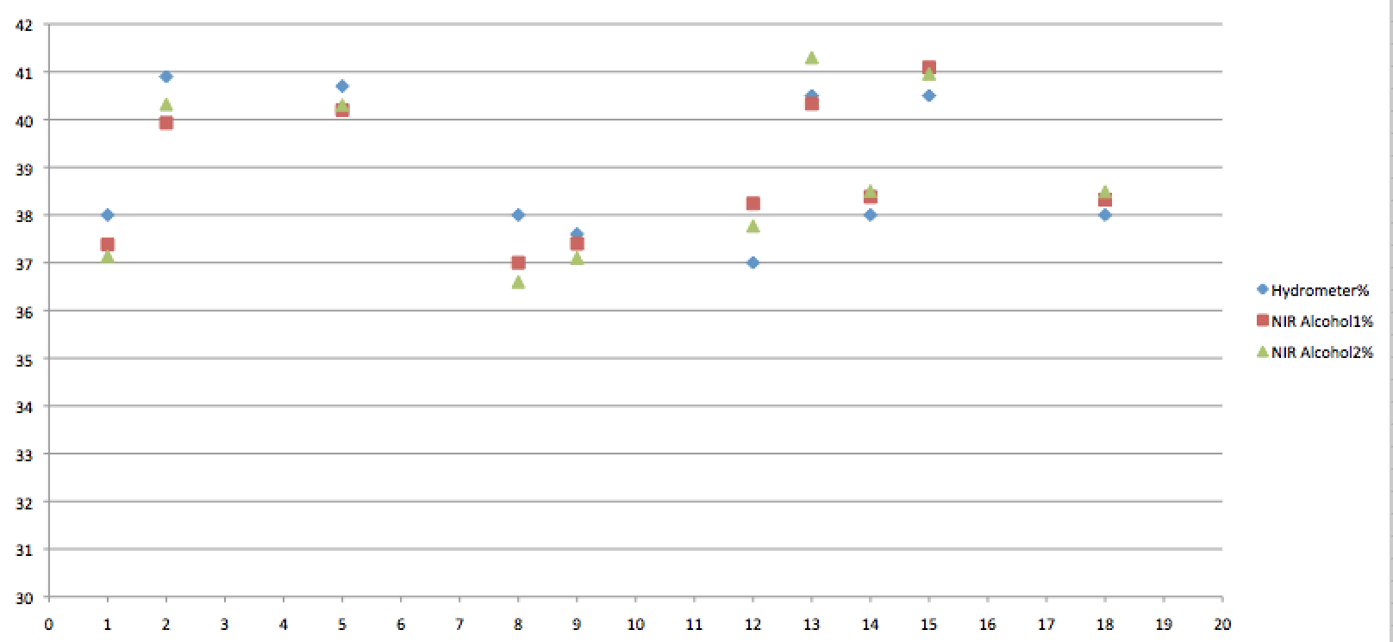
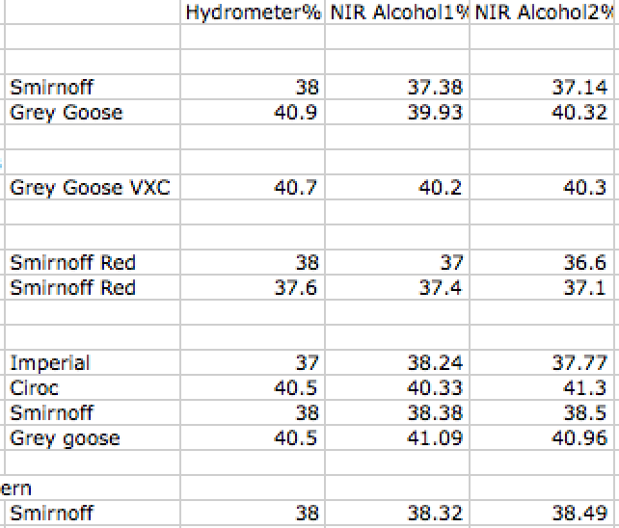
Recent field test2

Slide 16
Public Analyst results

Slide 17
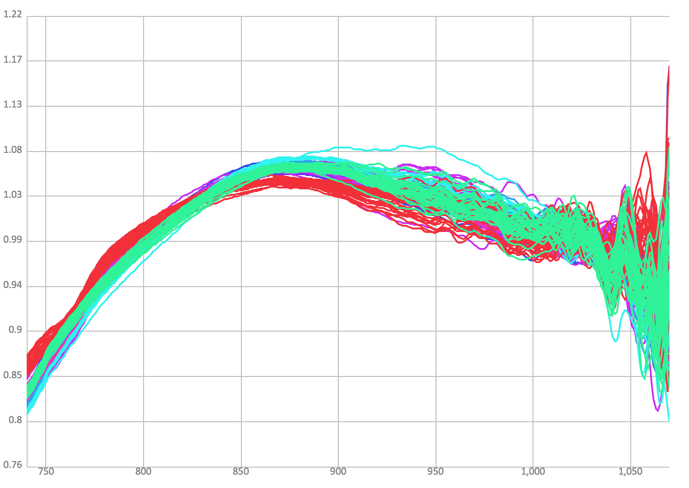


Instant National Picture
?API?
?Memex?
Notes:
Intelligence lead – maximising resources
Gathering an order of magnitude more information
Scores on the doors effect
So I built one and linked it to the handheld

Slide 18
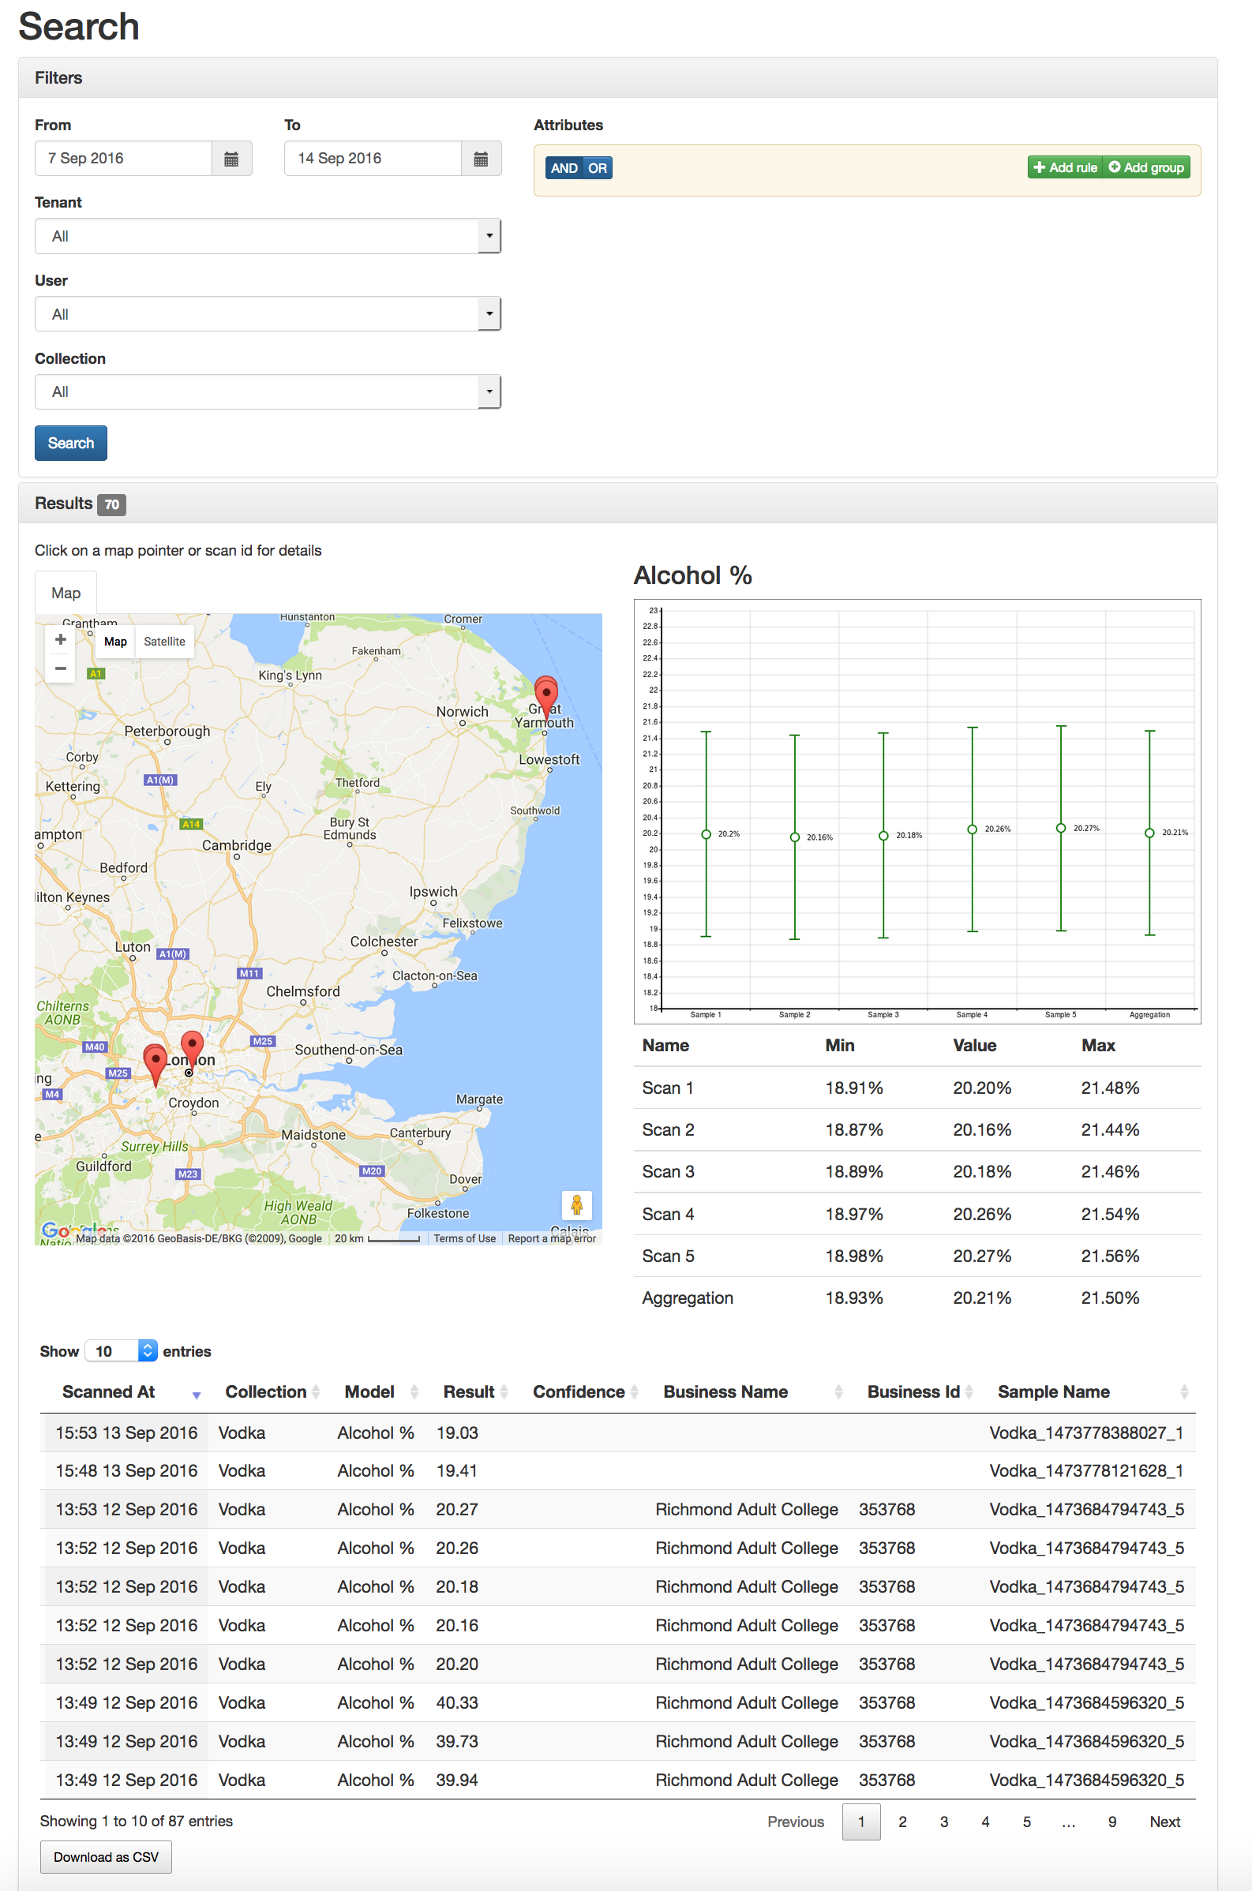

www.foodscan.co.uk
Database searchable by date, time
Location, Food Type, Scan result etc
Results plotted on map
Link with testing, notes, photos etc
Auto detection of food business id
Export to CSV, API etc

Slide 19
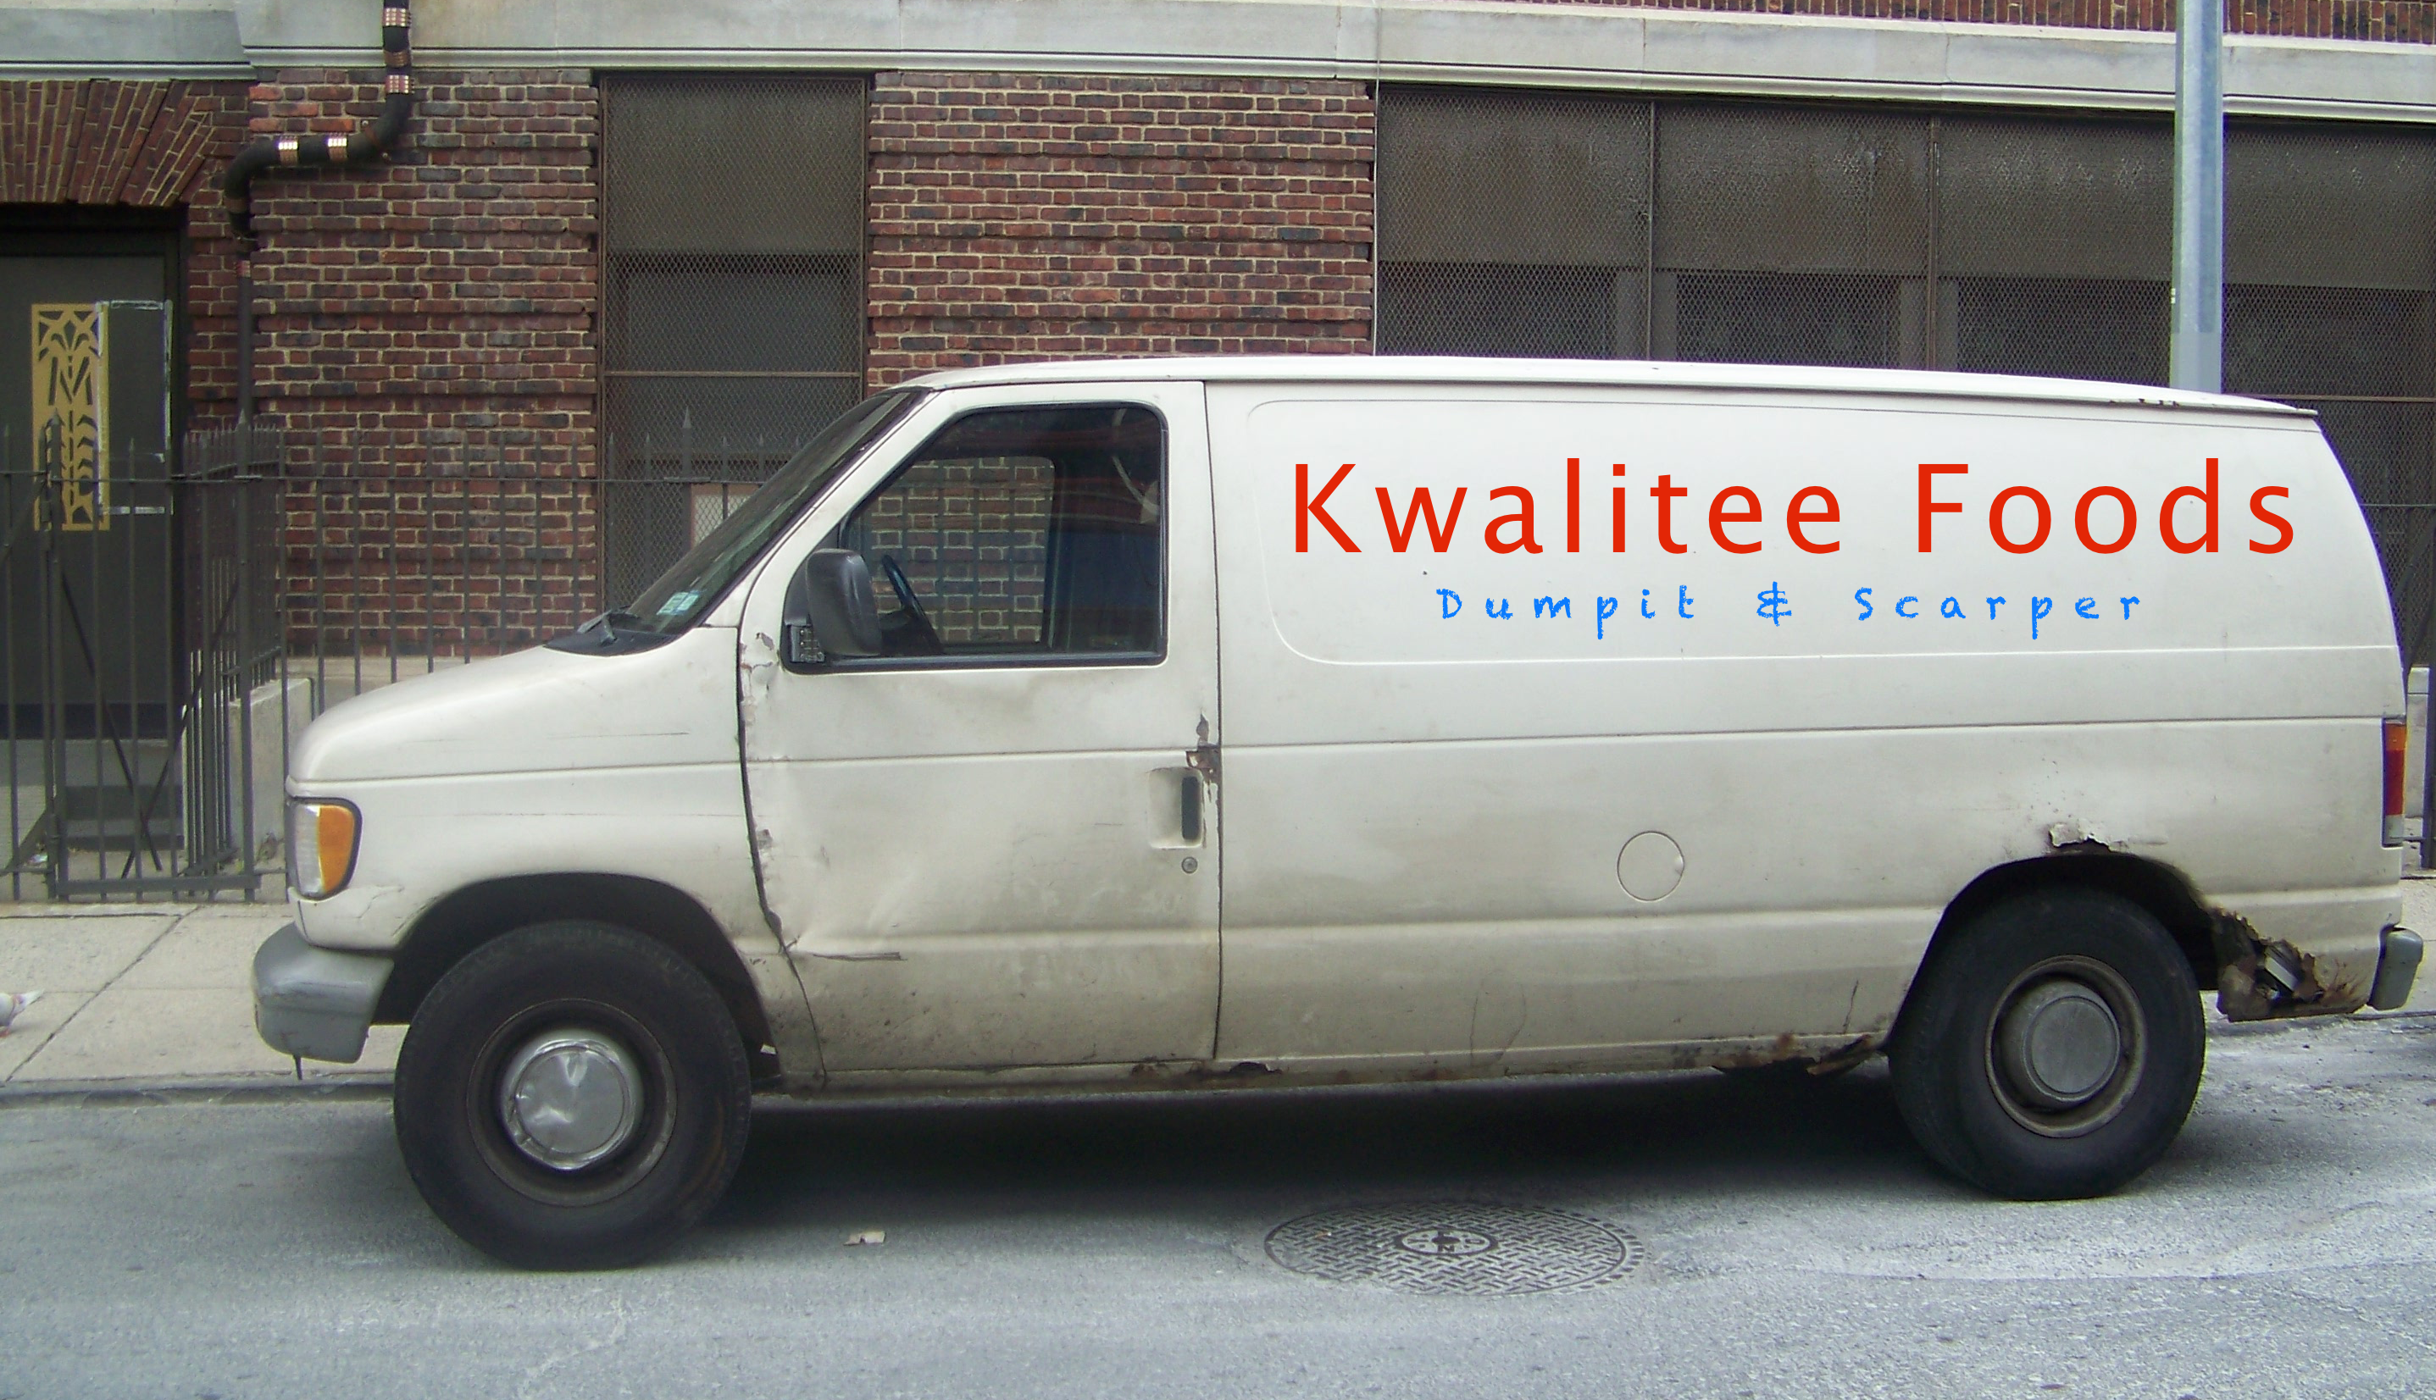
The ScoresontheDoors effect
Notes:
Seeing inspectors using gadgets to detect fraudulent food discourages Food Business Operators if they think they may get caught.

Slide 20
How will this help reduce food fraud?
Bottom up empowerment
Instant Screening
Encourages more sampling
Leverages existing field resource
Improved lab referral efficiency
National intelligence
Discourages offenders
Doing more with less

Slide 21
So what do we need next?
Some more forward thinking lead councils to help field trial
  How do the results compare with the lab?
  How does the percentage of verified samples compare?
  What practical issues in field use?

Slide 22
Thank you
Paul Hiscoe
Paul@PH-7.co.uk
07717 610511
Notes:
We are known for bottom up initiatives which empower field compliance.

