Slide 1
PHE Revision of Ships Waters Guidance
Allan Johnson
Out posted Scientist
PHE, FWEM, Colindale
Allan.johnson@phe.gov.uk

Slide 2
Why Revise
Guidelines For Water Quality On Board Merchant Ships Including Passenger Vessels- published 2003
Since which-
International Health Regulations (2005) – Ship sanitation certificate mandatory from 2007
EU -ShipSan Project – Started 2013
MGN 525- Guidelines for the provision of Food and Fresh Water 2015

Slide 3
Need to be consistent
With requirements of:-
WHO
ILO
MCA

Slide 4
Aim of review
Ensure that the guidance is not in contradiction of international and EU guidance.
Is relevant to all vessels, including those outside the scope of regulations and other guidance i.e. Commercial Inland vessels and craft under 24 metres
Ensure that gastrointestinal and respiratory organisms are covered

Slide 5
Challenges
Micro criteria
  What criteria is relevent?
EU Directive? – Aimed at mains water supply not stored water

Slide 6
EU Drinking Water Directive Criteria
Annex 1
Parameters and Parametric values
Part A
Microbiological Parameters
Parameter | Parametric value (number/100 ml)
Escherichia coli (E. coli) | 0
Enterococci | 0
The following applies to water offered for sale in bottles or containers:
Escherichia coli (E. coli) | 0/250 ml
Enterococci | 0/250 ml
Pseudomonas aeruginosa | 0/250 ml (If source influenced by surface waters)
Colony count 22°C | 100/ml
Colony count 37°C | 20/ml
ANNEX I PARAMETERS AND PARAMETRIC VALUES
PART A

Slide 7
Bottled Water Regs Criteria
quantitative determination of the indicators of faecal contamination,
showing absence of:
Escherichia coli and other coliforms in 250 ml;
Faecal streptococci in 250 ml;
Sporulated sulphite-reducing anaerobes in 50 ml;
and Pseudomonas aeruginosa in 250 ml.
determination of total viable colony count per millilitre of water at 20-22 °C in 72 hours and at 37 °C in 24 hours
No higher than source load

Slide 8
WHO Guidelines
Total coliforms 0/100ml
E. coli 0/100ml
Intestinal Enterococci 0/100 ml
C. perfringens 0/100 ml
HPC (ACC) No parameters but suggests 2 samples and looking at any differences
P. aeruginosa – Mentioned but no parameters
Legionella - Mentioned but no parameters

Slide 9
ShipSan
E. coli 0/100ml
Coliforms 0/100ml
Enterococci 0/100ml
C. perfringens 0/100ml
ACC 22°C No abnormal change

Slide 10
Legionella- Hot and Cold systems/Hot tubs
HSE/PHE Guidance
  < 100cfu/1000ml No action needed
  >100cfu - <1000cfu/1000ml Resample and review controls
  >1000cfu/1000ml immediate high level disinfection review of controls
  High proportion (>20% ve+ indicates colonisation, review controls, high level disinfection

Slide 11
Legionella
ShipSan (Based on EWGLI Criteria)
Hot and cold Systems
  < 1000 – Under control
  >1000 - >10,000- If small proportion 10%-20% ve+ resample
  >20% resample, review and disinfect
  >10,000 Immediate review and disinfection
Hot Tubs - >100 close pool, drain, clean and disinfect keep closed until no positives – 10 days

Slide 12
Which one?
Decision will be made by PHE in discussion with PHA’s

Slide 13
Non EU regs and guidance
China – Include bacillus spp.
Other countries?

Slide 14
Proposed Lay out
Basic requirements and parameters – Unlikely to change much fro existing but probably loosing ACC’s
Additional sections to cover technical details of systems.
Will cover all fresh water systems including non potable such as recreational waters.

Slide 15
Additions
Hot and cold system
  Source – Shore, barge, on board production and “others”
  Storage
  Disinfection – Cl, ClO2, Ag, UV etc
  Distribution – number of systems
Recreational
Pools, Hot tubs and fountains
Some technical waters – Screen wash, laundry,

Slide 16
What and where
Each section will have explanation of the key components, what they look like, what they do, what to check.
Common faults/problems and suggestions on corrective measures
It will not be another handbook for inspection but a technical reference to assist inspection using WHO/ ShipSan manuals

Slide 17
Trail
The intention is after production of draft to “test drive it”
PHO’s with experience
PHO’s with little experience
Students with no experience
If it works first time……………………………….

Slide 18
Source
Potable water can be bunkered by a number of means:
Shore supply.
In EU countries the quality of potable water must conform to the European Water Directive which set out microbiological criteria of absence of E.coli, coliforms and Enterococci, in addition it sets limits for ACC’s (Aerobic Colony Count) however, as these standards are set for mains piped supply and not water from storage tanks therefore it is not considered that ACC’s should be tested for in ships waters as, particularly on cruise ships large volumes are stored sometimes for extended periods and so ACC’s are likely to be present. The exception to this would be in circumstances where water is tested on a weekly basis where ACC’s could be a useful indicator when used to show trends.
Ships should request evidence, by means of a recent laboratory report, from the port, or in the case of inland vessels the owner of the dock or berth, of bunkering prior to accepting water. In the absence of a recent satisfactory report bunkering should be declined or the supply chlorinated at the higher level during and after bunkering to ensure quality.
The ship should record the port of bunkering, date and time of commencement of bunkering, the quantity taken in m3 or tonnes, the date and time of bunkering completion in the ships log or a log for this specific activity.

Slide 20
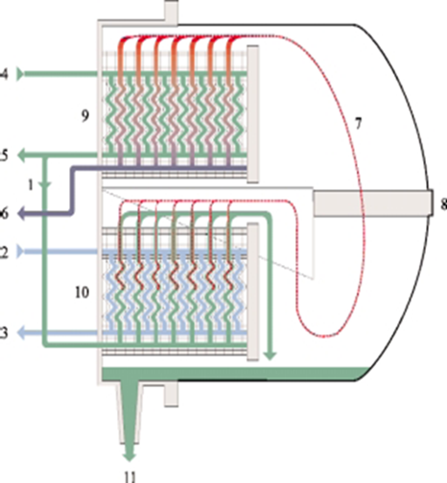
Seawater feed
2. Heating medium in
3. Heating medium out
4. Seawater cooling in
5. Seawater cooling out
6. Fresh water out
7. Evaporated steam
8. Demister
9. Condenser
10. Evaporator
11. Brine out

Slide 21
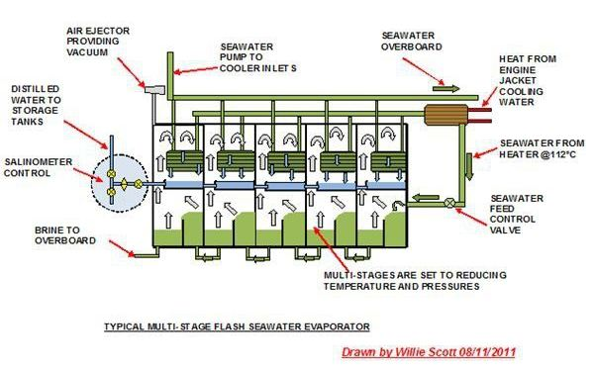
On large vessels such as cruise ships they may use “flash evaporators”

Slide 23
Thanks for your attention

