Slide 1
Port Health Training Day
22nd November 2017
Galley Hygiene and interim microbiology results for imported whole leaf herbs/spices at retail
Jim McLauchlin , FW&E Microbiology Services

Slide 2
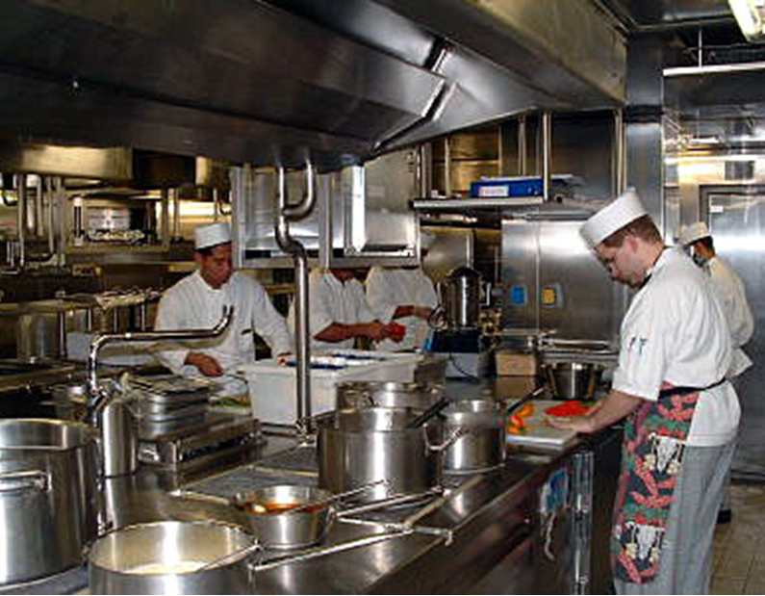
Galley hygiene survey
The International Labour Organisation’s Maritime Labour Convention (2006) states that each Member shall ensure that ships that fly its flag meet the following minimum standards:
the organization and equipment of the catering department shall be such as to permit the provision to the seafarers of adequate, varied and nutritious meals prepared and served in hygienic conditions; and catering staff shall be properly trained or instructed for their positions.

Slide 3
Galley hygiene survey
Limited published information regarding galley hygiene or the microbiological quality of food on ships
Due to the commercial pressure and the large number of passengers at risk on cruise ships, food hygiene on these ships is generally monitored and well controlled.
Hygiene on-board other commercial ships is less well understood.

Slide 4
Galley hygiene survey
Survey was developed to facilitate sampling of galleys in commercial ships other than cruise ships
Samples collected between November 2016 and June 2017 by Local Authority and Port Health Authority sampling officers and transported in accordance with the Food Standards Agency Food Law Practice Guidance
Officers were asked to take swabs of food preparation surfaces, chopping boards, hand wash sink taps, food preparation sink taps, knife blades, tin opener blades, internal surface of clean mixing bowls and/or internal surface of cleaned food storage containers
Samples were examined by PHE Food Water and Environmental Microbiology Laboratories at London, Porton and York

Slide 5
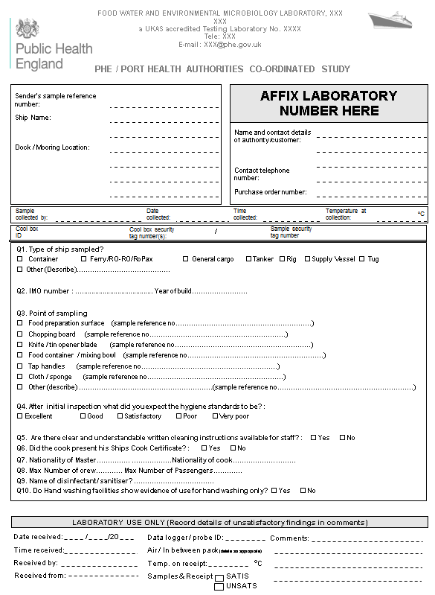
Galley hygiene survey
Data collected using a standard questionnaire

Slide 6
Galley hygiene survey: Ship type
Type of Ship | No. of samples | Satisfactory No. (%) | Borderline No. (%) | Unsatisfactory No. (%)
Bulk carrier | 111 | 56 (50.5) | 0 | 55 (49.5)
Container | 86 | 35 (40.7) | 2 | 49 (57.0)
Ferry | 61 | 48 (78.7) | 0 | 13 (21.3)
General cargo | 263 | 155 (58.9) | 0 | 108 (41.1)
Tanker | 320 | 184 (57.5) | 0 | 136 (42.5)
Other | 22 | 14 (63.6) | 0 | 8 (36.4)
Not stated | 88 | 41 (46.6) | 1 | 46 (52.2)
TOTAL | 951 | 533 (56.0) | 3 (0.3) | 415 (43.6)
Highest proportion of satisfactory results obtained from ferries

Slide 7
Galley hygiene survey: overall summary of the microbiology results
Type of Ship | No. of samples | Satisfactory No. (%) | Borderline No. (%) | Unsatisfactory No. (%)
Swabs | 904 | 530 (58%) | 3 (0.3%) | 371 (41%)
Cleaning cloths | 47 | 3 (6%) | 0 | 44 (94%)
TOTAL | 951 | 533 (56.0) | 3 (0.3) | 415 (43.6)
High proportion of unsatisfactory results

Slide 8
Galley hygiene survey: swabs
Sampling Point | No. of samples
 | Total | Satisfactory (%) | Borderline (%) | Unsatisfactory (%)
Chopping board | 195 | 80 (41.0) | 2 (1.0) | 113 (57.9)
Food container | 118 | 84 (71.2) | N/A | 34 (28.8)
Food preparation surface | 164 | 85 (51.8) | 1 (0.6) | 78 (47.6)
Handle (door / fridge etc) | 168 | 118 (70.2) | N/A | 50 (29.8)
Knife | 66 | 41 (62.1) | N/A | 25 (37.9)
Slicer | 12 | 7 (58.3) | N/A | 5 (41.7)
Tap | 75 | 29 (38.7) | N/A | 46 (61.3)
Tin opener | 36 | 30 (83.3) | N/A | 6 (16.7)
Utensil | 54 | 46 (85.2) | N/A | 8 (14.8)
Other | 6 | 4 (66.7) | 0 | 2 (33.3)
Not stated | 10 | 6 (60.0) | 0 | 4 (40.0)
Taps, chopping boards and food preparation surfaces least good quality

Slide 9
Galley hygiene survey: swabs
 | Swabs with template Bacterial counts (cfu per cm²)
 | <1 | 1- <10 | 10 -<10² | 10² -<10³ | 10³ -<10⁴ | ≥10⁴
Aerobic colony count | 8 | 5 | 16 | 12 | 8 | 3
Enterobacteriaceae | 29 | 5 | 8 | 3 | 5 | 2
E. coli | 52 | 0 | 0 | 0 | 0 | 0
Coagulase positive staphylococci | 50 | 2 | 0 | 0 | 0 | 0
unsatisfactory, borderline

Slide 10
Galley hygiene survey: swabs
 | Random area swabs Bacterial counts (cfu per swab)
 | <10² | 10² -<10³ | 10³ -<10⁴ | 10⁴ -<10⁵ | ≥10⁵
Aerobic colony count | Not applicable
Enterobacteriaceae | 511 | 147 | 87 | 61 | 46
E. coli | 847 | 5 | 0 | 0 | 0
Coagulase positive staphylococci | 837 | 15 | 0 | 0 | 0
unsatisfactory

Slide 11
Galley hygiene survey: cloths
 | Cleaning cloths Bacterial counts (cfu per cloth)
 | <10³ | 10³ -<10⁴ | 10⁴ -<10⁶ | 10⁶ -<10⁷ | ≥10⁷
Enterobacteriaceae | 1 | 4 | 8 | 4 | 30
E. coli | 35 | 0 | 9 | 0 | 0
Coagulase positive staphylococci | 43 | 2 | 1 | 0 | 1
L.monocytogenes | 47 | 0 | 0 | 0 | 0
Listeria species | 44 | 0 | 3 | 0 | 0
unsatisfactory

Slide 12
Comparison with studies of microbiological quality in mobile vendors
Study | % Satisfactory
 | Swabs | Cloths
Mobile Vendors 2006 | 46 | 13
Large Events 2009 | 62 | 29
Large Events 2010 | 68 | 44
Galley Hygiene 2016 | 58 | 6

Slide 13
Galley hygiene survey: Conclusions
Study represents hitherto unavailable data
More than a third of surfaces swabbed were of an unsatisfactory microbiological quality, with chopping boards, taps, food preparation surfaces and cleaning cloths being a particular concern in terms of cross-contamination risk.
Galley hygiene on ferries was better than for non-passenger ships. This may reflect an increased regime of inspections by Port Health Officers or other food safety consultants due to the larger number of people at risk on these ships.
Some similarities with microbiological quality of land based mobile vendors, however further analysis ongoing to compared hygiene with other land based food preparation settings

Slide 14
Galley survey: future actions
Complete report and place in public domain
Continued gather of an evidence basis to interpret results of environmental sampling: Guidelines in preparation
Need for comparisons with other land based land based food preparation settings
Need for advice on whether any action should (or can) be taken on unsatisfactory swabs. Ship has usually departed before the results are known, so the Port Health officers have difficulty knowing what to do with a failure that gets reported later. Hygiene failure usually of low risk, and some advice sent on to the shipping company on improving hygiene may be sufficient.
Keen to get feedback on the need to produce simple guidance that inspectors can give to ships staff when inspecting galleys to help improve hygiene in future

Slide 15



Fresh imported leaves
Betel leaves
Ready-to-eat food most commonly identified as contaminated with Salmonella with contamination rates higher than other similar products
Curry leaves
Street spice outbreak 2014
Presented data at point of import at
PH training day in 2016

Slide 16
Fresh imported whole leaves sampled at retail: Study duration April-December 2017
Interim results on 241 samples (April – Oct)
Leaf type | Total | Fresh | Frozen | Dried
banana | 54 | 30 | 24 | 0
curry | 106 | 101 | 4 | 1
betel | 66 | 66 | 0 | 0
Other & NK | 15 | 15 | 0 | 0
Other = vine, mango, pandane, karanja, kaffir, patra

Slide 17
Fresh imported whole leaves sampled at retail: April-October 2017
Countries of origin
Leaf type | India | Sri Lanka | Thailand | Bangladesh | Other | NK
banana | 1 | 4 | 31 | 0 | 8 | 10
curry | 23 | 8 | 1 | 0 | 4 | 40
betel | 16 | 6 | 2 | 1 | 7 | 21
Other & NK | 4 | 4 | 2 | 0 | 4 | 1

Slide 18
Fresh imported leaves at retail
 | Salmonella detected | E. coli enumeration
 |  | Satisfactory | Borderline | Unsatisfactory
banana | 3 (6%) | 26 (48%) | 16 (30%) | 12 (22%)
curry | 31(29%) | 14 (13%) | 46 (43%) | 46 (43%)
betel | 12 (18%) | 15 (22%) | 41 (62%) | 10 (15%)
Other & NK | 2 (13%) | 6 (40%) | 4 (26%) | 5 (33%)
All types of leaves can be contaminated with Salmonella
Curry leaves, least good microbiological quality
Microbiological quality significantly reduced in Sept-Oct after monsoon
Association between levels of E.coli and presence of Salmonella

Slide 19
Import restrictions for fresh leaves
Restrictions on the import of curry leaves
Fresh curry leaves can only be imported from countries able to fulfil the requirements of the EU import regulations. This includes the need to originate from countries recognised as free of citrus greening disease. Currently there are no countries that have satisfied this requirement and so fresh curry leaves are not permitted to be imported into the EU. If curry leaves are imported they must be either frozen or dried at time of import
(https://www.gov.uk/guidance/protecting-plant-health-topical-issues)
Paan leaves from Bangladesh
2014 EU Commission implemented a temporary suspension of imported betel leaves originating or consigned by Bangladesh (Decision 2014/88/EU) which was extended in June 2015 (Commission Implementing Decision 2014/510/EU) and then to June 2018 (FSA 2016).

Slide 20
Fresh imported leaves at retail: conclusions
Study ongoing and will have two more months of sampling and testing
Curry leaves, least good microbiological quality
Similar occurrence of Salmonella contamination in betel leaves between import and retail
Microbiological quality significantly reduced in Sept-Oct after monsoon
Association between levels of E.coli and presence of Salmonella
Not clear if fresh curry leaves have been pre-frozen
1 sample of paan leaves were identified as from Bangladesh which is subject to restrictions and should not be imported into the UK
Information on country of origin, durability and intended information often absent

