Slide 1
The Ballast Water Management Convention
Leanne Page
Environmental Policy Lead

Slide 2
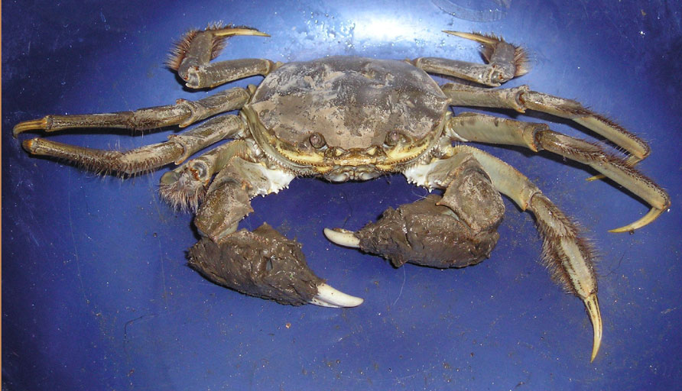
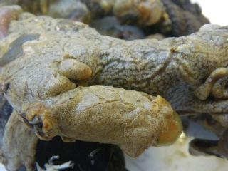
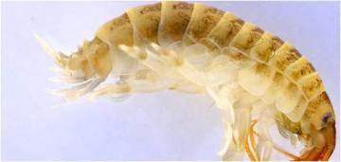
Background
Why?
  One of the UN’s ‘four greatest threats to global biodiversity’
  Estimated up to 7 billion tonnes of water moved around the globe per year
  Non-indigenous species potentially introduced
Why bother?
  Increases in ships, ballast volumes
  Changes to environment
Potential impacts
  Environmental
  Economic
  Social
Notes:
Speed of ships

Slide 3
Convention Application
All vessels entitled to fly flag of a Party
Survey and Certification applies to ≥ 400gt
< 400gt Administrations to determine compliance
Exclusions
  Not carry ballast
  Remain within waters of a single party (domestic)
  Single Party and high seas
  Government ships
  Permanent ballast in sealed tanks not subject to discharge
Notes:
Not yet decided how gong to deal with <400gt.
Not use domestic, operate in waters of a single party
High seas – determining definition

Slide 4
Requirements
Manage ballast water
  D1 – Ballast Water Exchange
  D2 – Ballast Water Discharge Standard
Ballast Water Management Plan
Ballast Water Record Book
Ballast Water Management Certificate (≥ 400gt)
Sediment Management
Notes:
All this has been delegated to class
D2 – Treatment Equipment
Record book – UK not producing one, will provide a downloadable form that can be used on website
Conv only requires cert to >400gt but may extend this to <400gt
Sediment – remove and dispose inline with BWM Plan

Slide 5
Implementation
Schedule
Convention is now in force
Must meet D1 or D2 until required to meet D2
D2 implementation is based upon IOPP Certificate renewal
What about non-IOPP vessels?
  Administrations to determine compliance.
  Meet D2 no later than 2024
Notes:
D2 is treatment system or can discharge ashore or use an Other Method – no OM yet approved by IMO

Slide 6
Implementation
Schedule
8/9/17 Entry into Force | 8/9/17 – 7/9/18 | 8/9/18 - 7/9/19 | 8/9/19 – 7/9/20 | 8/9/20 – 7/9/21 | 8/9/21 – 7/9/22 | 8/9/22 – 7/9/23 | 8/9/23 – 7/9/24 | 8/9/24 onwards
 | 1st IOPP Renewal following EIF |  |  |  |  | D2 Compliance (2nd Renewal following EIF)
 |  | 1st IOPP Renewal following EIF |  |  |  |  | D2 Compliance (2nd Renewal following EIF)
 |  |  | D2 Compliance (1st IOPP Renewal following EIF)
 |  |  |  | D2 Compliance (1st IOPP Renewal following EIF)
 |  |  |  |  | D2 Compliance (1st IOPP Renewal following EIF)
 | Vessels that do not hold an IOPP Certificate (implementation schedule to be determined by Administration but no later than 8/9/24) |  |  |  |  |  |  | D2 Compliance
 | Ships constructed on or after EIF – D2 Compliance

Slide 7
D1 - Ballast Water Exchange
95% volumetric exchange or pump through 3 times the volume of each ballast tank
  a) At least 200nM from nearest land and water >200m deep but if unable to:
  (b) As far from nearest land as possible and in all cases at least 50nM from nearest land and in water 200m deep
(If (a) and (b) not met then areas can be designated by port State
If not meet D1 must record in Record Book
Notes:
Less than 3x is acceptable if can prove at least 95% vol change has been met.
Ships do not have to delay or deviate to meet a or b but may be requested to do so to use designated areas

Slide 8
Intra North Sea BWE
BWM.2/Circ.56
Comes into force with the Convention
Terminates once vessels have to meet D2
Red areas high risk (No D1)
Error on Image
IMO ‘Agreement’
Notes:
No exchange in red areas
Intra North Sea only
Use co-ordinates listed in Circ not just the image
Not include areas of the Irish Sea (Not the North Sea)
No other UK designated exchange areas

Slide 9
D2 – Discharge Standard
Sets number of organisms present in discharged ballast water
Treatment equipment
IMO Type Approved (>60 systems)
UK accept all IMO type approved equipment but down to Class to ensure meet Class Rules
Can use an Other Method or discharge ashore
Notes:
10 viable organisms per cubic meter – different sizes >50um , <50um & >10um
cholera <1 colony forming unit per 100ml, E-Coli 250CFU 100ml, Intestinal enterocci 100 cfu 100ml
Viable definition change dead/live to reproductive viability
Different technologies – UV, electrochlorination, filtration, cavitation, gas injection
UK has type approved 2 systems – a UV (Hyde Marine) and an inert gas system (Coldharbour)

Slide 10
Other Methods
Must be approved by IMO, via Administration
  None approved to date
Fresh Water
  Potable
  Municipal
Containerised BWMS
  Shoreside / Barge
Internal Circulation
Notes:
Not necessarily too late if looking at alternative to D2

Slide 11
Exceptions & Exemptions
Exceptions
  Emergency situations, accidental discharges, avoiding/minimising pollution
  Uptake and discharge on the high seas
  Same Location
Exemptions
  Risk Assessment based
  Complicated
  UK open to applications
  HELCOM/OSPAR approach
Notes:
Accident - provided reasonable precautions unless recklessness
High seas as already mentioned not yet defined – outside of EEZ
Same Location – looking at use of port security plan areas or harbour designation orders
Exemptions – Very specific term Not just a paper exercise Gov not pay for, complicated – port, coastal and flag State. Probably too late at this time

Slide 12
Current Status
Entered into force on Friday 8th September, 2017
UK has not yet ratified and does not have implementing legislation in place
Currently working with FCO, lawyers and economists to produce UK legislation.
What does this mean
  Can not prosecute under specific BWMC laws
  Impact on work of PHA’s ?
Notes:
Not meet entry in to force. A little chicken and egg with SI.
Due to FCO advice, UK will now wait for the amendments to the Convention to enter into force.

Slide 13
Port State Control
Four Stage Inspection Process
  Initial Inspection
    Focus on documentation and designated personnel
  More detailed inspection
    Operation of BWMS and BWMP is reviewed
  Stages 3 & 4 involve sampling the water
    Indicative Analysis
    Detailed Analysis

Slide 14
Thank you for listening
Any Questions ?

