Slide 1




APHA Training Day
ROF Update
November 2017
22 November 2017
Michael Jackson

Slide 2
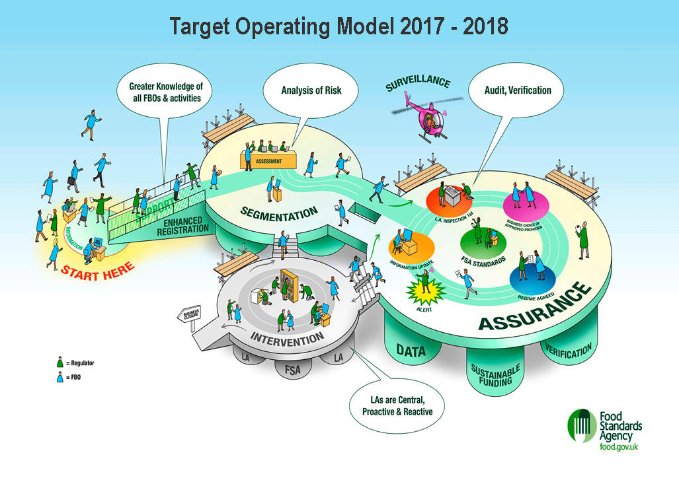


Slide 3
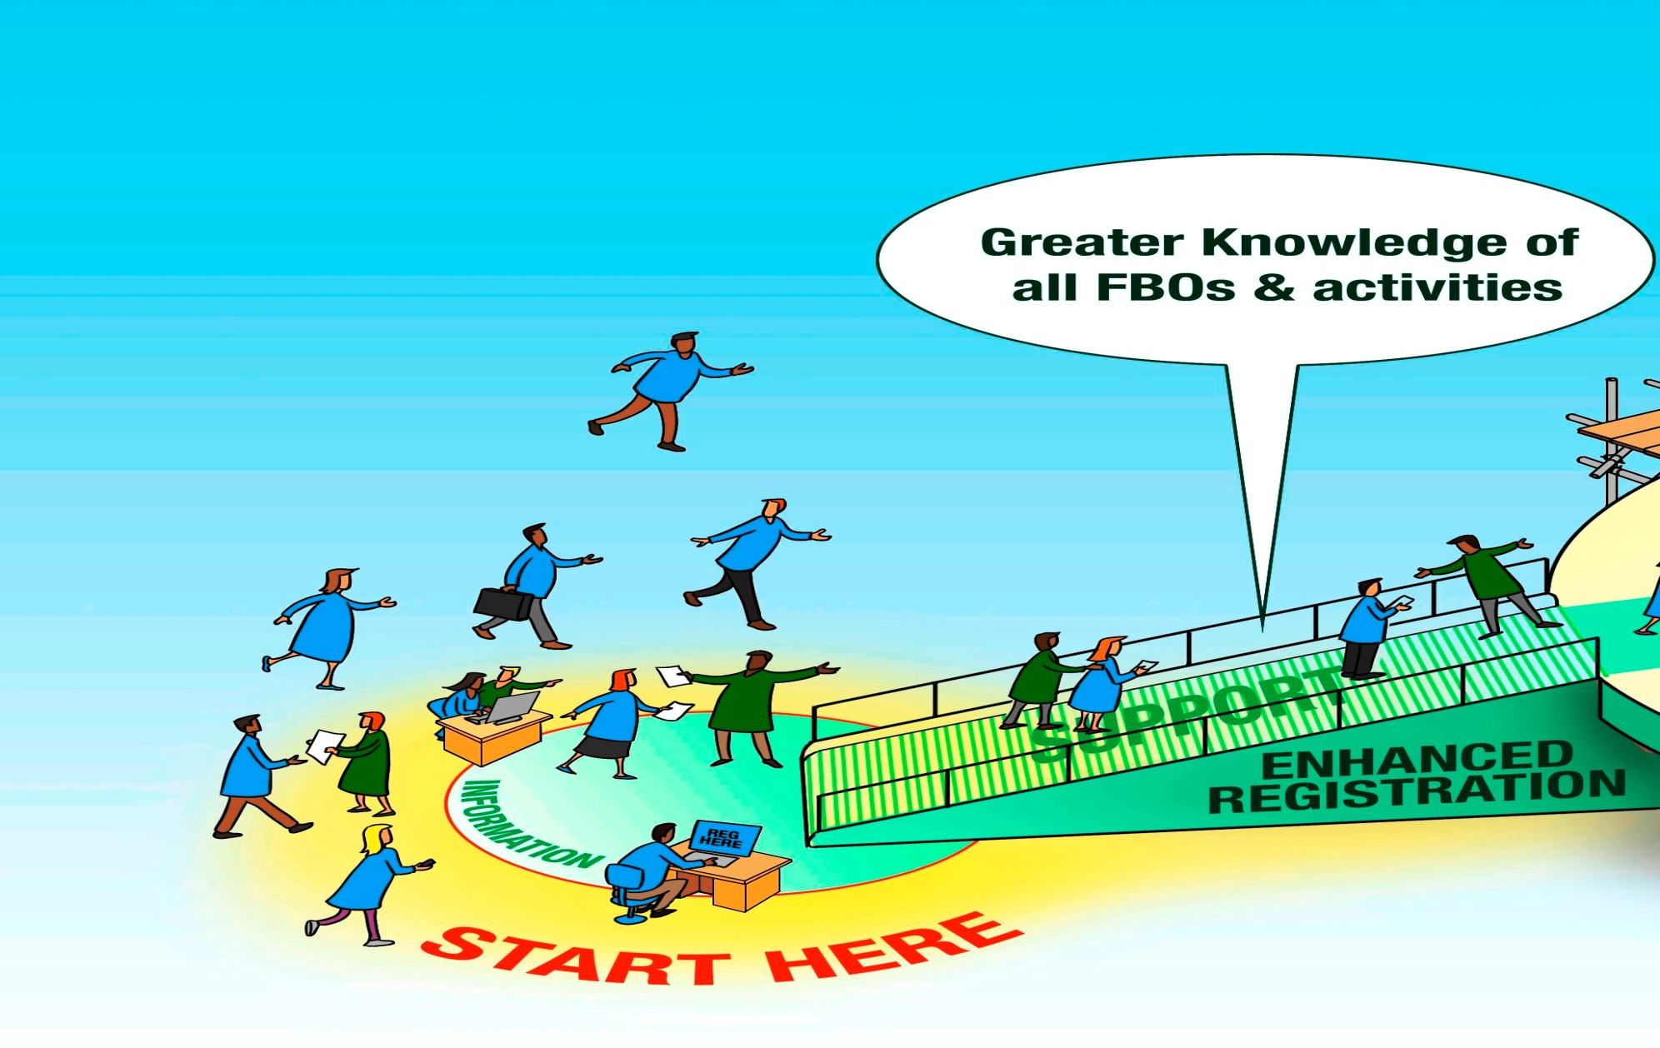



Slide 4
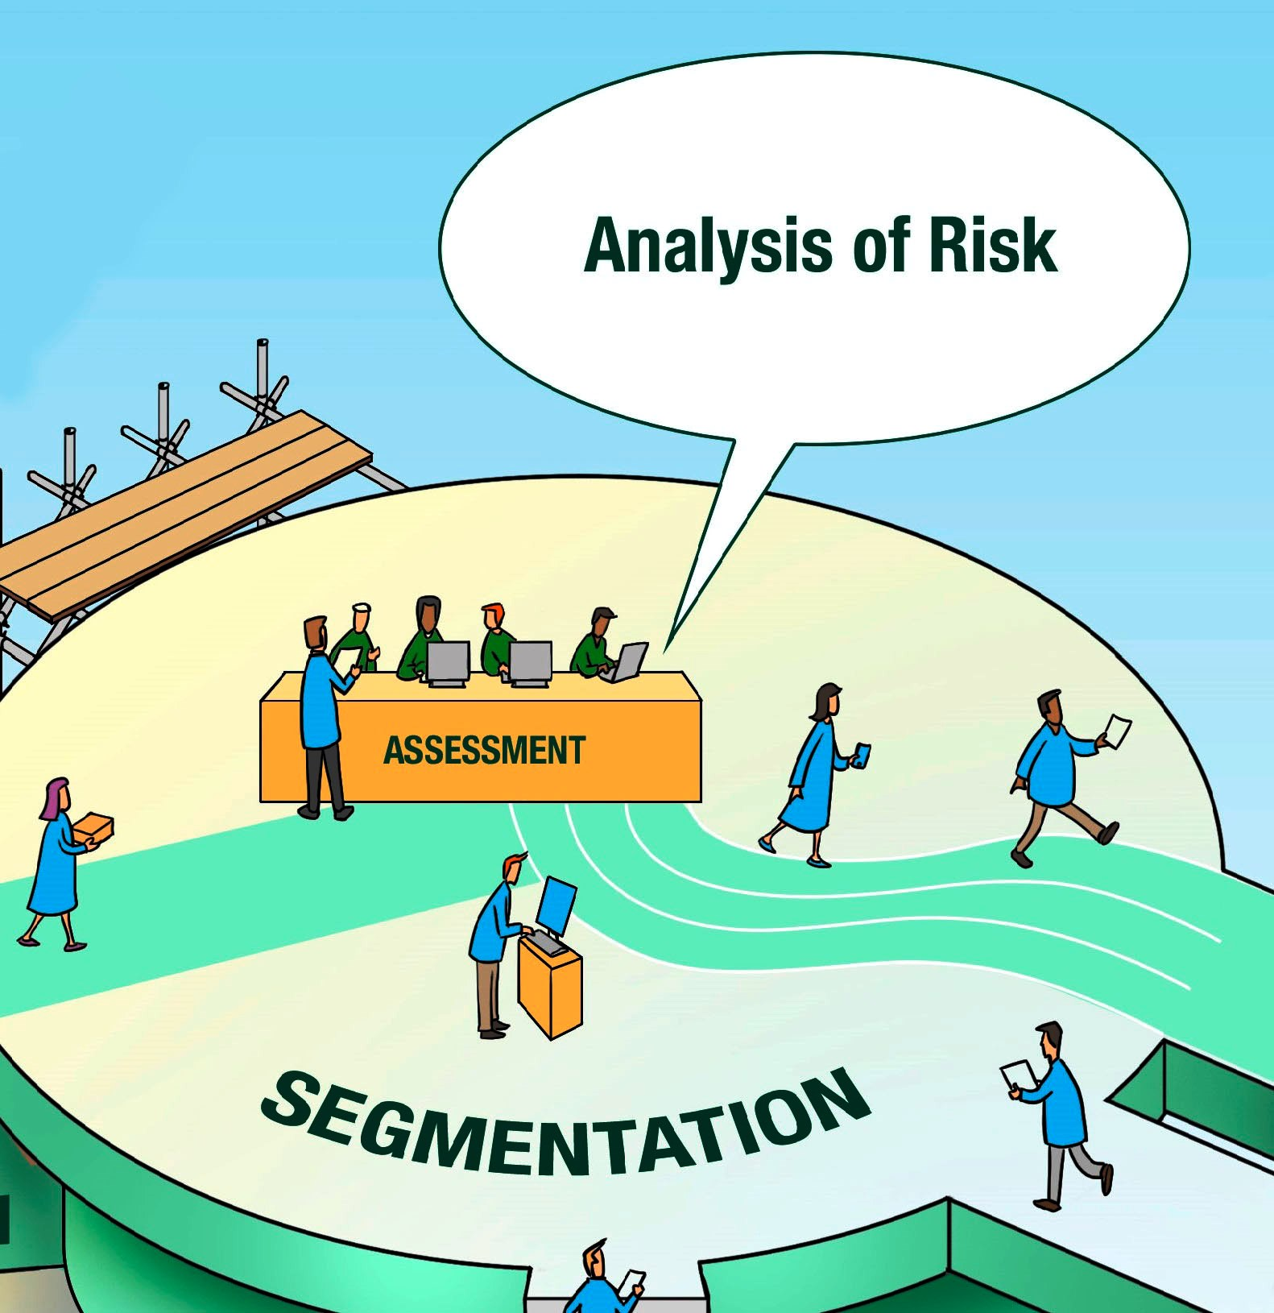


Slide 5
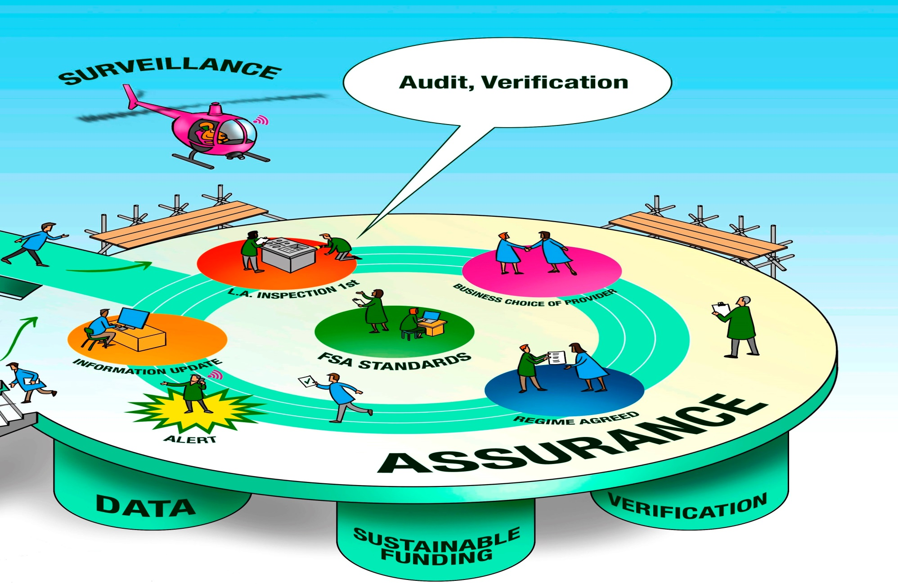

Slide 6
