Slide 1
Port Health Work by the PHE Food, Water and Environmental Microbiology Services
Jim McLauchlin 30th November 2016

Slide 2
Introduction to the service
Need for reconfiguration
Work with Port Health Authorities
Public health responses to an outbreak associated with an imported food
Supporting food regulation of an imported food

Slide 3
FW&E Microbiology Services
Expert advice and access to laboratory services for food, dairy, environmental and water microbiology
National microbiological survey and surveillance data
Early recognition, notification, investigation and control of unusual events and outbreaks
Evidence base to inform the actions of PHE and others
Training of staff in the PHE and external partners
Applied R&D to support and progress all of the above
3
Notes:
3
3

Slide 4
Stakeholder and partner engagement
  Local Authorities, Port Health Authorities,
  NHS
  Other Parts of PHE
  APHA, CIEH, Food Standards Agency, Defra, DH, DWI, EA, EFSA, EU, ECDC
  Food Industry, Water Companies, Trade Associations, others ….
4

Slide 5
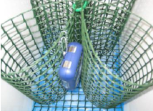
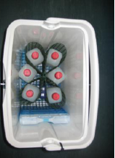
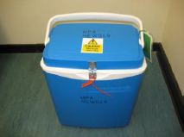
FW&E Microbiology Services:
Annual Workload
~170,000 samples processed by five laboratories
  ~50% for LAs and PHAs
  ~45 NHS Trusts and other healthcare settings
Workforce of ~130
  Transport and logistics
  Testing
  Reporting and interpretation
  Witness statements
  Liaison and Training
  Sampling support
5

Slide 6
Network of Laboratories
All Official Control Laboratories
Accredited to ISO 17025
National specifications for:
  Service, transport, Interpretation of laboratory test results, Laboratory test methods, Microbiological Test Parameters
  National SOPs and standardised test methods
Single National LIMS system
  Various options for reporting and data outputs
  Fully compatible with UKFSS
6

Slide 7
Front line laboratories: food water and environmental samples
Reasons for sampling and testing:
  Surveys and monitoring
  Part of inspections by Local Authority or Port Health Authority
  Complaints
  Outbreak investigation
  Monitoring and surveillance
  Statutory testing (designation of shellfish harvesting sites, Food Control)

Slide 8
FW&E Position in 2015
2015-2017, significant reductions in central funding and a continuing need for efficiency savings
Configuration not affordable within central funding
After a consultation process, PHE announced on 14th April 2016 to reconfigure the Services onto three sites and retaining FW&E laboratories at;
        London
        Porton
        York
8

Slide 9
Option agreed with PHE Senior Management
The preferred option will provide an affordable service for the future with:
No change in Local Authority or Port Health Authority allocation to continue at the same level for 2016-17
Appropriate response to outbreaks or public health incidents
Distributing the work previously sent to the Preston and Birmingham laboratories to an alternative site

Slide 10
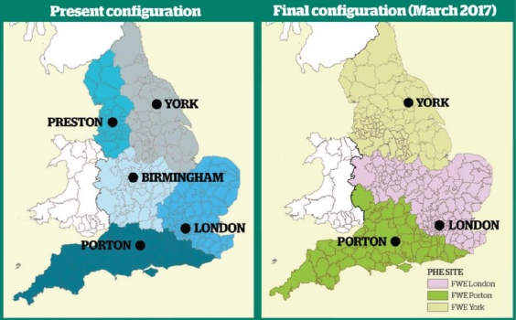
FW&E Reconfiguration

Slide 11
Key messages
PHE is fully committed to delivering a high quality FW&E Microbiology Service to Local Authorities, Port Health Authorities and to other parts of PHE
The professionalism and the expertise of the PHE staff in Preston and Birmingham has never been questioned
PHE will work with public sector stakeholders to ensure a smooth transition to new agreed working arrangements
Development of microbiology services delivered from three laboratory sites
Reinvestment in staff and facilities

Slide 12
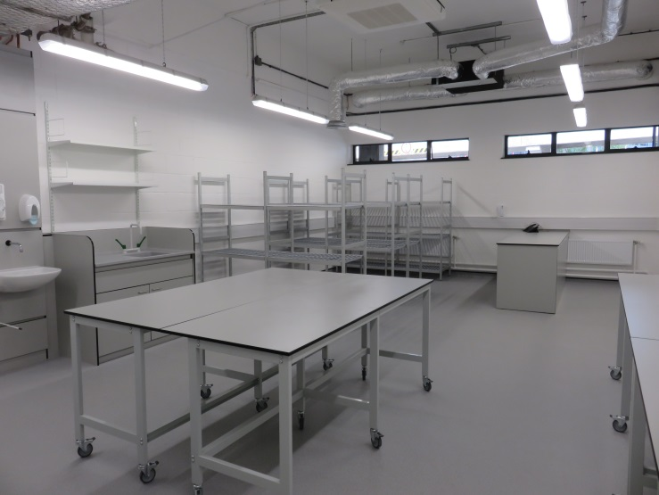
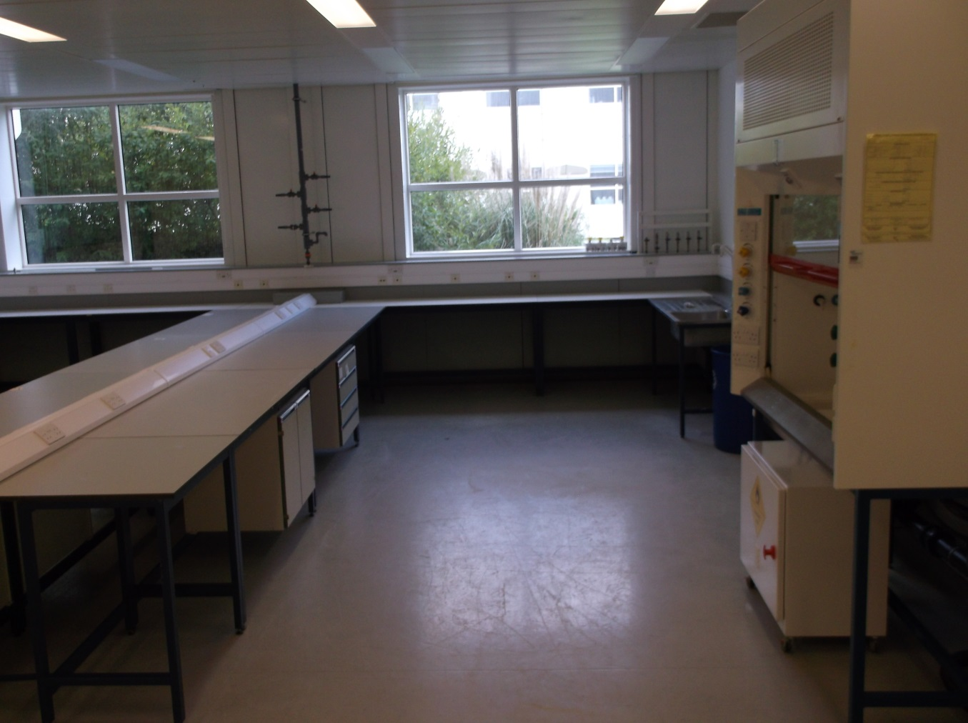
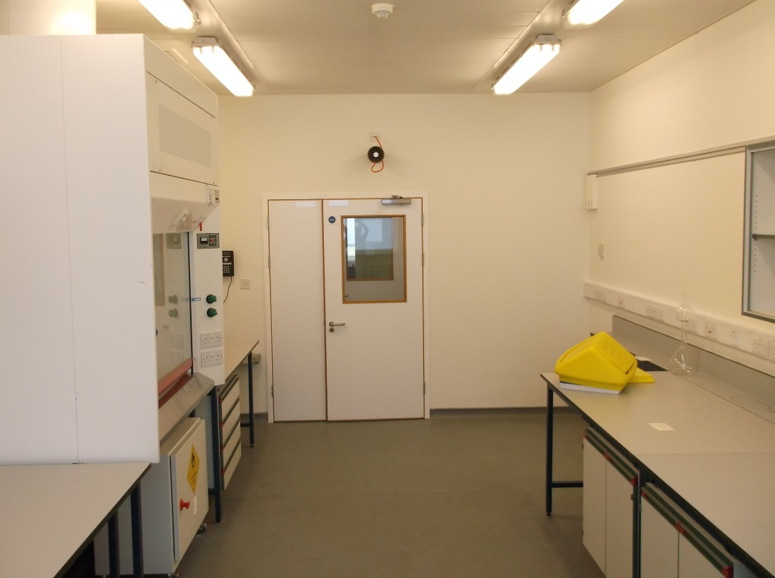
Infrastructure: increased laboratory space at York and London

Slide 13
FW&E working with Port Health Authorities

Slide 14
PHA workload by PHE 2015-16
Ports including:
Bristol, Cornwall, Hull &
Goole, London, Manchester,
Mersey/Liverpool, Poole,
Portsmouth, Plymouth,
River Blyth, Southampton,
Suffolk Coastal, Tyne,
Weymouth.
Airports
Heathrow,
Gatwick,
Birmingham,
Manchester.
Approximately 5,000 samples tested pa
*Excluding shellfish for statutory classification

Slide 15
PHA work-types 2015-16
12% Foods,
not specified
FoAO: e.g. chicken, fish, shellfish, other meats, gelatine, dairy products (cheese / ice-cream), pet food, and composite products
FoNAO: e.g. cereals, herbs and spices, dried seeds, fruit and vegetables (fresh and processed)
Waters: Legionella, potable (ship sanitation certificates)
Advice: Working group formed for producing Guidelines on Legionella on ships
13% FoNAO
15% FoAO
60% Waters

Slide 16
Co-ordinated survey:
Hygiene in Ship Galleys
Food hygiene on cruise ships generally monitored and carefully controlled
Hygiene on-board other commercial ships is less well understood
Survey developed to facilitate sampling of galleys in commercial ships
      November 2016 to March 2017
Information relating to the cleaning standards and practices
      Collected using specific proforma
    Plus up to 5 swab samples per ship may be submitted
      Random area swabs: Enterobacteriaceae, E.coli, Staphylococcus aureus
      Measured area swabs: ACC, Enterobacteriaceae, E.coli, S.aureus
      Cloths: Enterobacteriaceae, E.coli, S.aureus, Listeria

Slide 17
FW&E working with Port Health Authorities:
Public health responses to an outbreak associated with an imported food

Slide 18
Salmonella Newport outbreak:
Initial observations
28th November 2011
  The FW&E Laboratory, Preston recovered & identified a Salmonella in a sample of melon collected at retail
  Food Standards Agency informed
  6th December
  The Reference Laboratory at Colindale confirmed this as Salmonella Newport
18
Presentation title - edit in Header and Footer

Slide 19
Co-ordinated international surveillance response
ECDC (European Centre for Disease Prevention & Control) informed & Epidemic Intelligence Information System (EPIS) interrogated
    Outbreak of S. Newport first identified in Holland 21st November 2011.
    Further cases identified in Germany
    Epidemiological association with consumption of mung beans
  Subsequent comparison of Pulsed Field Gel Electrophoresis (PFGE) typing profiles & antibiotic resistance showed that the melon isolate was unrelated to the Dutch/German outbreak
19
Presentation title - edit in Header and Footer

Slide 20
December 2011
The UK Food Standards Agency
Trace back of melons identified that they originated from Brazil
Melons sliced in the UK
Contamination could have occurred in UK or in Brazil
EU Rapid Alert System for Food & Feed (RASFF No 2011.1837).
No cases identified in the UK
Product was past its Best Before date - assumed all product had been consumed.
Review of typing of S. Newport cases in England & Wales (before 2012) – none melon associated
20
Presentation title - edit in Header and Footer

Slide 21
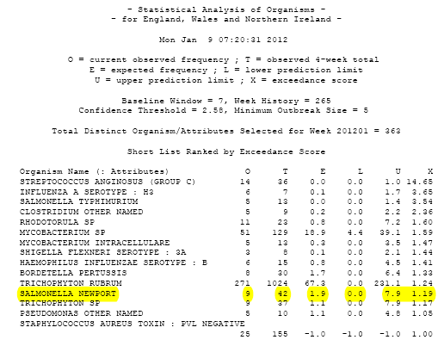
Combing results of phenotypic analysis of bacteria with reported numbers of cases
January 2012
Exceedance Algorithm: Observed versus expected disease produced automatic-
ally every
week
21
Presentation title - edit in Header and Footer

Slide 22
Initial actions
December 2011 Scotland reported an increase in S. Newport cases in late
Trawling questionnaires used in England & Wales
16 January 2012 First Outbreak Control Team meeting held
  Health Protection Agency (now PHE)
Health Protection Scotland
Food Standards Agency UK
22
Presentation title - edit in Header and Footer

Slide 23
First OCT outcomes
Case definition agreed:
  Laboratory confirmed, indigenous, fully sensitive S. Newport
  Outbreak PFGE profile SNWPXB.0110
  Reported between 1st December 2011 & 3rd February 2012.
      (Subsequently amended to include travel-associated cases)
EPIS alert posted, including PFGE profile
PFGE profile sent to Scotland
23
Presentation title - edit in Header and Footer

Slide 24
Subsequent OCT outcomes
Trawling identified a significant excess of watermelon consumption
Cases identified in;
  England & Wales
  Northern Ireland
  Scotland
  Germany (joined 19th January)
  Ireland (joined 30th January)
Bespoke common questionnaire produced
24
Presentation title - edit in Header and Footer

Slide 25
Molecular typing results
Match between typing date from different countries & the watermelon isolate.
No match to any patterns in PulseNet Latin America
25
Presentation title - edit in Header and Footer

Slide 26
Epidemiological results
A total of 63 confirmed cases identified:
      31 in England
      5 in Scotland
      4 in Wales
      2 in Northern Ireland
      4 in Republic of Ireland
      17 in Germany
    72% female, majority aged 5 years or less
    Thirteen cases hospitalised: three died (links to underlying health conditions)
Final OCT held on 3rd February - no new cases were identified, outbreak declared as over
26
Presentation title - edit in Header and Footer

Slide 27
Outcomes
Phenotyping of Salmonella allowed:
the identification of an international outbreak due to S. Newport associated with consumption of imported watermelons from Brazilian
35 cases in E&W, but part of a multi-national outbreak
Rapid linkages with epidemiological IT databases to identified & defined the geographical extent of the outbreak & its source
European Commission mandated analysis of 5% of batches of watermelons from Brazil arriving at European ports (Implementing Regulation (EU) no. 618/2013)
27
Presentation title - edit in Header and Footer

Slide 28
Testing at BIPs of consignments of watermelons originating from Brazil: January – Sept 2013
Year | Consignments | Analysed | Salmonella detected
Q1 | 353 | 24 | 0
Q2 | 8 | 0 | 0
Q3 | 11 | 11 | 0
Q4 | Delisted
Total | 525 | 35 | 0
Results from EU 27 plus Norway
European Food Safety Authority. Scientific Opinion on the risk posed by pathogens in food of non-animal origin. Part 2 (Salmonella in melons). EFSA Journal 2014;12(10):3831

Slide 29
FW&E working with Port Health Authorities:
Supporting food regulation of an imported food

Slide 30
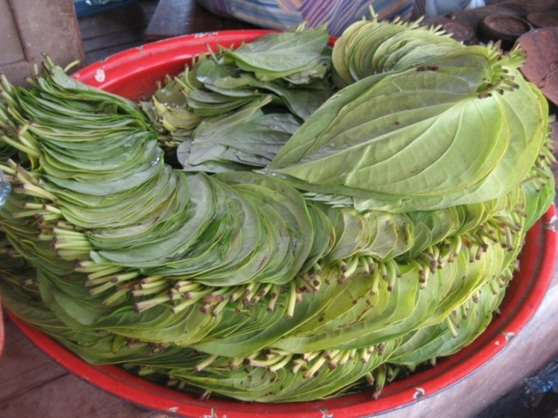
Betel leaves, initial observations
Betel (paan) leaves (Piper betle L.) traditional product that certain South-eastern Asian populations chew after meals
Imported into the EU particularly to UK, Germany and Italy
2012 exports from Bangladesh >€40 million (Food Law Latest, 2015)
August 2011
EHO sampled betel leaves as part of an inspection of an ethnic food retailer in Birmingham
Samples tested by FW&E Laboratory in Birmingham
Salmonella enterica serovar Augustenborg isolated

Slide 31
Betel leaves, 2011 HPA testing
September to December 2011
further retail sampling in Birmingham and London detected Salmonella
99 consignments received at Heathrow each represented by 5 separate samples (total 493) tested, 83% were from Bangladesh, 16% from India and 1% from Thailand
Salmonella isolated from 75% of all samples. Results from testing consignments ranged from not detected to Salmonella detected in all samples.
44 serovars of Salmonella were identified
A comparison with isolates from human cases in early 2012 did not identify betel-consumption attributable morbidity in the UK population

Slide 32
Actions by Risk Managers
2011 after initial isolation of S.Augustenborg, FSA informed who issued RASFFs, discussions held with the Bangladeshi and Indian High Commissions to ascertain what is being done to reduce contamination in the country of origin
2014 EU Commission implemented a temporary suspension of imported betel leaves originating or consigned by Bangladesh (Decision 2014/88/EU) which was extended in June 2015 (Commission Implementing Decision 2014/510/EU) and then to June 2018 (FSA 2016).
2014 Betel leaves from India and Thailand were subjected to an increased level of official control at the designated point of (Commission Implementing Regulation (EU) 323/2014) and this continued for India in September 2015 (Commission Implementing Regulation (EU) 2015/1607).
2016 control of betel leaves from India extended requiring that consignments be accompanied by results of sampling and analysis by the competent authorities in India for the presence of Salmonella (Commission Implementing Regulation (EU) 2016/166).

Slide 33
Betel leaves, 2012-16 results of FW&E testing in PHE:
Year | Total | Number of samples tested |  | Salmonella detected (%)
 |  | BIPs at 4 airports | Retail
All samples | 1228 | 1152 | 76 | 232 (19%)
2016 | 42 | 41 | 1 | 7 (17%)
2015 | 138 | 116 | 22 | 27 (20%)
2014 | 187 | 473 | 42 | 17 ( 9%)
2013 | 356 | 345 | 9 | 62 (17%)
2012 | 505 | 505 | 0 | 119 (24%)

Slide 34
Betel leaves, results of FW&E testing: 2012-16
Year | Salmonella detected/total tested
 | Bangladesh | India | Malaysia | Nepal | Pakistan | Sri Lanka | Thailand
All samples | 125/591 (21%) | 50/347 (14%) | 10/28 (36%) | 2/5 (40%) | 0/1 . | 3/21 (14%) | 17/110 (15%)
2016 | . | 0/5 | 10/28 | 2/5 | . | 2/3 | .
2015 | 0/2 | 14/102 | . | . | . | . | .
2014 | 12/96 | 4/39 | . | . | 0/1 | 0/1 | 0/25
2013 | 22/128 | 23/121 | . | . |  | 0/7 | 15/75
2012 | 91/365 | 9/80 | . | . | . | 1/10 | 2/10

Slide 35
Betel leaves: conclusions
Ongoing problem of contamination
Contamination rates higher than other similar products
  Salmonella detected in 9/774 (1.2%) of fresh herbs on retail sale in 2014 (Willis et al., 2015)
Contamination occurs in multiple countries, application of country specific controls unlikely to be effective
Substantial exposure for Salmonella to a specific ethnic group
Ongoing analysis of the Salmonella types and comparison of those causing disease in England
Consumption of betel leaves linked to cases of typhoid in India
  Singh et al., J Food Prot 2006;69:288-92.

Slide 36
Examples of FW&E working with Port Health Authorities
Access to expert advice and laboratory services for food and water microbiology to Port Health Authorities
National microbiological surveys and surveillance data on vessels and imported foods
Early recognition and notification of unusual events to allow investigation and control of outbreaks associated with imported food
Evidence base to inform the actions of risk managers
Applied R&D to support and progress all of the above

Slide 37
Questions and comments?

