Slide 1
Seafish activities: tuna fraud, superchilling, crystal violet
Ivan Bartolo
Regulatory Affairs Advisor

Slide 2

Seafish is a Non-Departmental Public Body (NDPB) set up by the Fisheries Act 1981 to improve efficiency and raise standards across the seafood industry.
Our Mission: to support a profitable, sustainable and socially responsible future for the seafood industry
Promoting consumption
Enhancing reputation
Informing decisions
Notes:
Funded by a levy on Seafood
Run by an independent Board appointed by Defra
Draw upon recommendations from 3 Sector Panels: Domestic and Export, Processing and Import, Supply Chain and Consumers

Slide 3
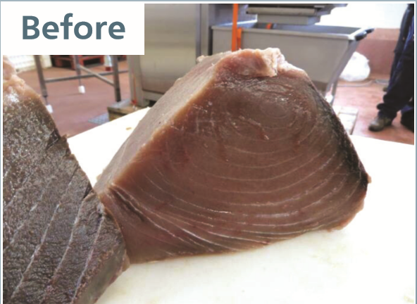
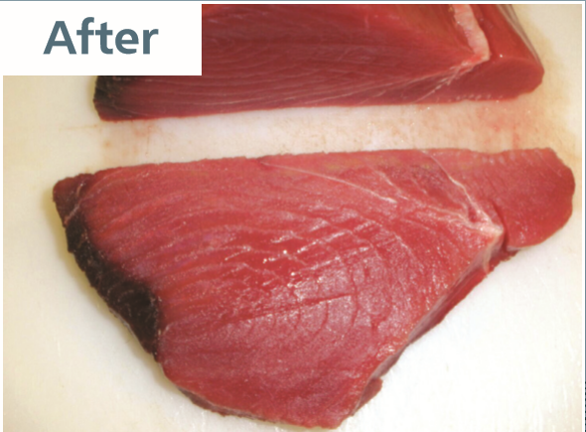
Industry Collaboration to Address Tuna Fraud

Slide 4
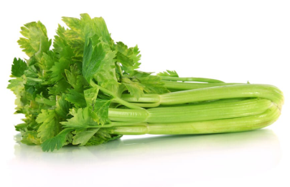
What nitrate treatment does
Low quality tuna is brown
Defrosted tuna quickly turns brown
Nitrification changes the brown myoglobin component to red
Antioxidants (ascorbic acid, erythorbate or Vit C) are needed to complete the reaction
Perceived higher value. Consumers are misled on the quality
Notes:
OxyMb (cherry red) → deoxyMb (purplish red) and as Fe2+→Fe3+ it becomes MetMb (brown). MetMb+NO→NitrosylMb (red). You need ascorbic acid/Vit C or erythorbate to fix.
Tuna intended for canning only need be frozen at -9 degrees. This does not preserve the red colour of fresh tuna and causes the brown colour seen in the top photo. In canning this is not an issue as the colour changes during canning. To maintain the fresh red colour it must be super frozen which is much more expensive.
Treating the brown tuna with nitrates creates a permanent change of colour from brown to red and it can be sold as high quality fresh red tuna. This was seen previously where CO gas was used for the same purpose. CO gas only preserves the colour it could not reverse the reaction from deterioration. Red tuna could be kept red but brown tuna could not be restored to red. Making this new development with nitrates more harmful. Both processes mask the signs of deterioration. It is these signs that alert the consumer to possible histamine contamination and food safety risks. CO treatment was prohibited as it was considered a food safety risk and this process needed to be prohibited as well.
The issue had been raised by the UK at the Commission working group on additves, Member states agreed it should not be permitted, but kept on approving the process and the treatment chemicals were openly promoted at trade shows.
This was a bit confusing to us with national authorities saying it wasn’t permitted but approving premises carrying out the treatment. With free movement of goods the products were widely available throughout Europe. It is currently estimated to be around 85% of the ‘fresh’ tuna on the market.
It was decided to go directly to the Commission, they were aware of the issue through the working group on additves and had previously confirmed that vegetable extracts as an additive were not permitted but no further action had been taken by the Commission or member states to communicate or enforce this.
We arranged meeting with DG SANTE to present a dossier of facts to them. They were pleased we had brought this to them and said it was the first time business had come to them with a food fraud case. They had been unaware of the scale of the problem and the other associated fraud such as tax and IUU
We then needed to draft a letter based on discussions to get official confirmation of discussions. We did this is the format used by MEPs in their written questions.

Slide 5
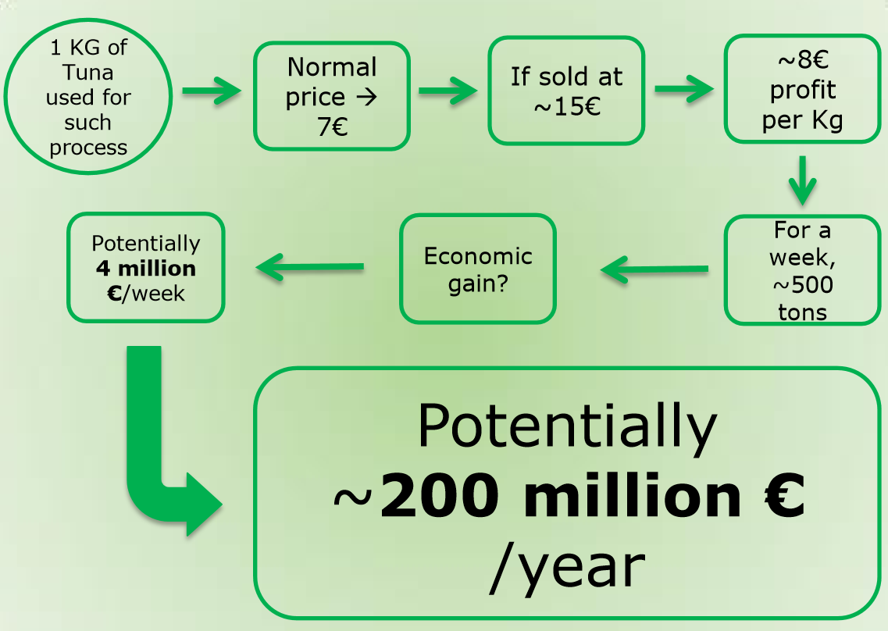
Notes:
The next slides give some detail of those elements although some are self explanatory
This shows the financial gain from the treatment and the scale of the problem and therefore the potential loss to the consumer. The important part to demonstrate is the financial loss to the consumer. This was considered worse than horse meat because of the financial value

Slide 6
Non-compliance
Hygiene rules: freeze below –18°C.
  Except tuna intended for canning: – 9°C
Marinated or treated tuna is considered ‘unprocessed’.
  Very few additives are permitted
  (ascorbates, erythorbates, citrates, phosphates OK)
Ensure consistent interpretation of the law in all member states
Notes:
The initial points of non compliance we focussed on
Hygiene rules state that fish should be frozen below -18 degrees. There is an exemption for tuna intended for canning which can be stored at -9 degrees. This means tuna using this exemption must go for canning. Not thawed or frozen or any other use.
Clarify that marinated tuna is still unprocessed under food law and therefore some additives used are not permitted. By arguing the act of treating tuna makes it ‘processed’, more additives are permitted. This was dismissed as the tuna is sold as an unprocessed product.
Ensure consistent interpretation of the rules in all member states. Some member states allowed vegetable extract as a flavouring , despite it having no flavour.

Slide 7
Legislation: Regulation 1334/2008
Defines ‘flavouring’:
  an ingredient not intended to be consumed as a food, but which is added to food in order to impart or modify odour and/or taste
Additionally, flavouring ingredients
  do not pose a safety risk, and
  their use does not mislead the consumer.
Notes:
The letter to the Commission was set out in the way MEPs ask written questions. The applicable legislation is set out and then the commission asked if they agree with our interpretation. This leaves less room for ambiguity.
This was just one point made in the letter to the Commission. This relates to the issue of vegetable extract being used as a flavouring and therefore being permitted. The full letter and response can be circulated in necessary

Slide 8
The Question
Does the Commission agree that this vegetable extract is not a ‘flavour’ if it does not impart any odour or taste? And should not be permitted as flavouring if it poses a safety risk and misleads the consumer?
Notes:
Then the question we asked of does it meet the criteria?
Every potential non compliance was covered in this way in the letter.

Slide 9
The Outcome
Letter of confirmation circulated to businesses around the EU
FVO informed
Production stopped across the EU
Notes:
The Commission issued a letter answering our questions and confirming that the process should not be permitted. This was sent to individual member states.
DG SANTE made presentations around the EU. The FVO were also informed to include in their inspection program.
This was successful and production stopped briefly, but the process was modified slightly as we had focussed on the method and not the activity. So we had to go back to DG SANTE for further clarity.

Slide 10
Additional Clarity
Confirm that transforming colour of tuna by any means is fraud
Consistency between member states on interpretation of regulation
Use traceability as a control measure
Take action against the food additive companies selling non-authorised additives or selling additives for fraudulent purposes
Notes:
This time we needed to
Confirm that transforming colour by any means is fraud. The use of vegetable extract was confirmed as not permitted but this did not stop modified treatments being used for the same purpose. Vegetable extracts were substituted with other sources of nitrates. As buyers became aware of this treatment the processors found new ways to describe the same process making it hard for the buyers to know what they were buying and protect their businesses.
Consistency between member states on interpretation of regulation. Antioxidant use is permitted at Quantum satis or the levels needed to achieve the purpose. There is no maximum. The levels considered necessary vary greatly between member states. We asked for antioxidants to be prohibited in all tuna or maximum limits set below that needed in the transformation reaction.
Traceability. Only a very limited number of purseiners can do non brine tuna suitable for selling as fresh tuna.
Approx. 40 boats and only around 20 are EU approved. Tuna from any other boats must go to a cannery
Take action against the food additive companies selling non authorised additves or selling additives for fraudulent purposes to reduce the availability of necessary additives.
A follow up letter was sent by DG SANTE to confirm it was the transformation of tuna that was the fraudulent activity. and they are looking at regulating the use of antioxidants, traceability and the supply of chemicals.
Enforcement action is being taken in countries known to be permitting this treatment.

Slide 11
Learning
More than one member state needs to be involved
But does not need to be an official organisation
The businesses must have tried to resolve the issue with their national competent authorities
The fraud and financial loss to the consumer should be significant
Identify where there are non-compliances with EU regulation.
Target the fraudulent activity not the method
Any other areas of fraud
Notes:
What we learnt was important when taking an issue to the Commission
More than one member state need to be involved but did not need to be an official organisation, This was a group of individual businesses with the technical knowledge of the problem, with one person acting as the point of contact.
The businesses must have tried to resolve the issue with their own national competent authorities. The commission were pleased that the businesses had come directly to them to highlight fraudulent practices but also that they had tried to resolve it at a national level first.
The fraud and financial loss to the consumer should be of a significant size , they were aware of this issue as the UK had raised it previously, but not concerned until made aware of the scale of production.
Point out where there are non compliances with EU regulation. The Commission need direct questions related to the regulations. We modelled our letter on MEPs questions to the Commission. This is a format of setting out the problem and the answer and asking if they agree.
It is important to target the actual fraudulent activity and not the method. Initially we targeted the treatment and not the intention. This made it easy to find new ways to continue the fraud. Initially we focused on the use of vegetable extract as a source of nitrates. The Commission issued a letter clarifying this was not permitted and production stopped for a week or so. However the process was modified to use high levels of antioxidant and salt of nitrates. This is permitted and labelled as salt and antioxidants but the result of transforming the tuna is the same.
Any other fraud, in this case, tuna destined for canning is exempt from duty when imported into the EU, so there was tax avoidance and significant loss to the EU. There was also a link to IUU fishing with illegally caught tuna being used. While not used in the dossier presented any other areas of fraud are useful in getting the Commission to take action.

Slide 12
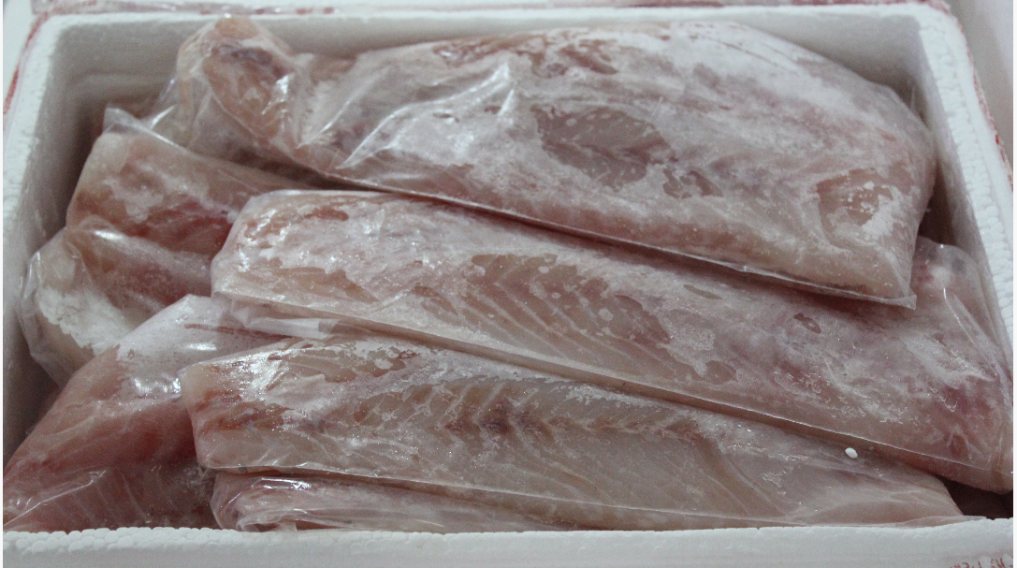
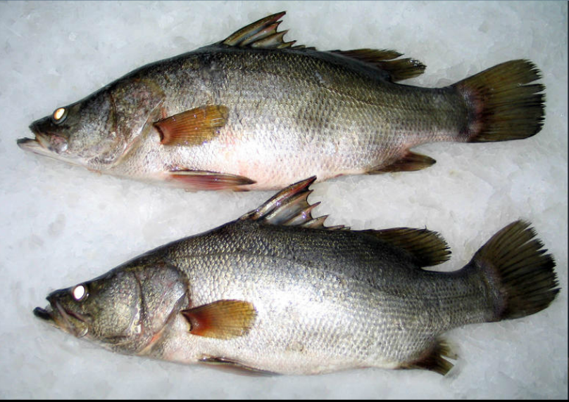
Superchilling

Slide 13
The superchilling issue: chronology
6/2013 SCOFCAH: France, “melting ice”
4/2014 SCOFCAH: general reluctance to define in terms of °C
10/2015 Exp Gp: Roissy Airport loses Nile perch trade. It has been rejecting Nile perch from Kenya Uganda Tanzania because arriving at -2.5/-1°C. COM describes that the perch is frozen to -20°C and allowed to thaw en route, a practice known as superchilling
12/2016 Exp Gp: German representative comments that properly applied superchilling is different and in compliance with hygiene package
4/2017 Exp Gp: Italian representative had earlier raised the issue of Nile perch from Uganda arriving as “superchilled” although evidently thawed en route. COM explained that this was “superchilling” and therefore illegal.
6/2017 Italian authorities share information with Seafish

Slide 14
What is superchilling?
Reducing the temperature of fish uniformly to a point slightly below that obtained in melting ice (Torry Research Station, 1967).
Storage of fish at temperatures at 0°C to -4°C is called superchilling or partial freezing (Huss, FAO, 1995).
Storage between the freezing point of the products and 1–2°C below this (Dunn & Rustad, 2008)
A method of preserving food by partial ice-crystallization (Kaale & Eikevik, 2014)
Notes:
This time we needed to
Confirm that transforming colour by any means is fraud. The use of vegetable extract was confirmed as not permitted but this did not stop modified treatments being used for the same purpose. Vegetable extracts were substituted with other sources of nitrates. As buyers became aware of this treatment the processors found new ways to describe the same process making it hard for the buyers to know what they were buying and protect their businesses.
Consistency between member states on interpretation of regulation. Antioxidant use is permitted at Quantum satis or the levels needed to achieve the purpose. There is no maximum. The levels considered necessary vary greatly between member states. We asked for antioxidants to be prohibited in all tuna or maximum limits set below that needed in the transformation reaction.
Traceability. Only a very limited number of purseiners can do non brine tuna suitable for selling as fresh tuna.
Approx. 40 boats and only around 20 are EU approved. Tuna from any other boats must go to a cannery
Take action against the food additive companies selling non authorised additves or selling additives for fraudulent purposes to reduce the availability of necessary additives.
A follow up letter was sent by DG SANTE to confirm it was the transformation of tuna that was the fraudulent activity. and they are looking at regulating the use of antioxidants, traceability and the supply of chemicals.
Enforcement action is being taken in countries known to be permitting this treatment.

Slide 15
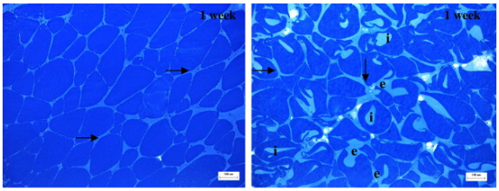
Some superchill considerations
Shelf life extension
Quality preservation
but
Ice crystal size and growth have to be carefully controlled
Notes:
This time we needed to
Confirm that transforming colour by any means is fraud. The use of vegetable extract was confirmed as not permitted but this did not stop modified treatments being used for the same purpose. Vegetable extracts were substituted with other sources of nitrates. As buyers became aware of this treatment the processors found new ways to describe the same process making it hard for the buyers to know what they were buying and protect their businesses.
Consistency between member states on interpretation of regulation. Antioxidant use is permitted at Quantum satis or the levels needed to achieve the purpose. There is no maximum. The levels considered necessary vary greatly between member states. We asked for antioxidants to be prohibited in all tuna or maximum limits set below that needed in the transformation reaction.
Traceability. Only a very limited number of purseiners can do non brine tuna suitable for selling as fresh tuna.
Approx. 40 boats and only around 20 are EU approved. Tuna from any other boats must go to a cannery
Take action against the food additive companies selling non authorised additves or selling additives for fraudulent purposes to reduce the availability of necessary additives.
A follow up letter was sent by DG SANTE to confirm it was the transformation of tuna that was the fraudulent activity. and they are looking at regulating the use of antioxidants, traceability and the supply of chemicals.
Enforcement action is being taken in countries known to be permitting this treatment.

Slide 16
The superchilling issue: chronology
6/2013 SCOFCAH: France, “melting ice”
4/2014 SCOFCAH: general reluctance to define in terms of °C
10/2015 Exp Gp: Roissy Airport loses Nile perch trade. It has been rejecting Nile perch from Kenya Uganda Tanzania because arriving at -2.5/-1°C. COM describes that the perch is frozen to -20°C and allowed to thaw en route, a practice known as superchilling
12/2016 Exp Gp: German representative comments that properly applied superchilling is different and in compliance with hygiene package
4/2017 Exp Gp: Italian representative had earlier raised the issue of Nile perch from Uganda arriving as “superchilled” although evidently thawed en route. COM explained that this was “superchilling” and therefore illegal.
6/2017 Italian authorities share information with Seafish

Slide 17
The superchilling issue: chronology
9/2017 Commission is willing to open the discussion on new technologies providing that they are in line with EU legislation and with food safety requirements
10/2017 PAFF: Not discussed
Latest: COM seeking feedback from industry on superchilling technology: cod, salmon, squid etc.

Slide 18
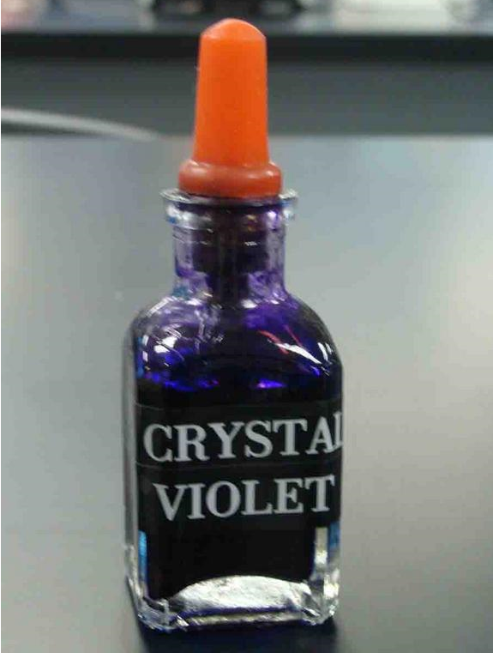
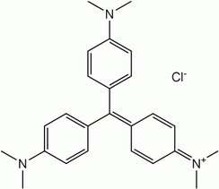
Crystal Violet Case Study

Slide 19
Crystal violet
A non-approved dye (zero tolerance applies)
Antimicrobial properties, considered genotoxic
Historically a Reference Point for Action (RPA) of 2 µg/kg has been applied
EFSA 2017: A toxicological screening value of 0.0025 µg/kg body weight per day
For an adult this is 0.5 µg/kg of fish

Slide 20
Case study
Importer receives test certificate: <1 µg/kg
…but in the accompanying email: “CV is present at between 0.3 and 0.6 µg/kg”
What should the importer do?

Slide 21
Further clarification from lab
The Limit of Quantification is 1 µg/kg
CV is widely used: in blue paper towels, blue and black inks (ball point pens, inkjet inks), antifreeze, fertilizers, detergents, leather
Absence of leuco-CV suggests post-harvest contamination

Slide 22
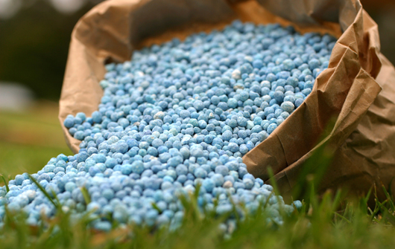
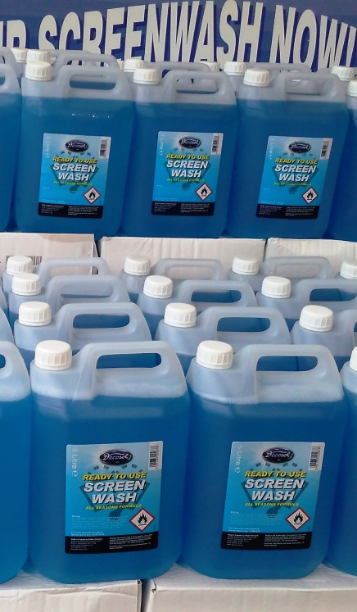

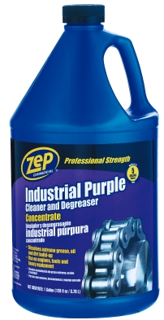
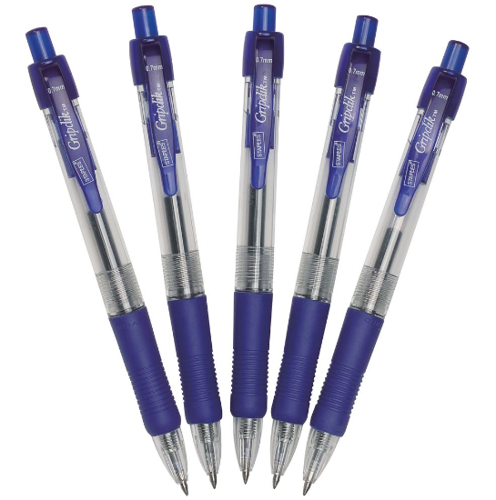
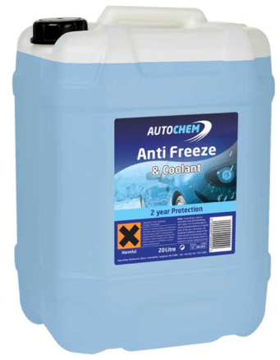
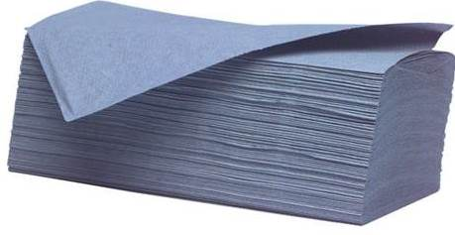
Do any of these contain crystal violet?

Slide 23
A repeat test gave a negative result.
It was concluded that the traces of crystal violet found were due to sample contamination.
The shipment was released.

Slide 24
Thank you
Ivan.Bartolo@seafish.co.uk

