Slide 1
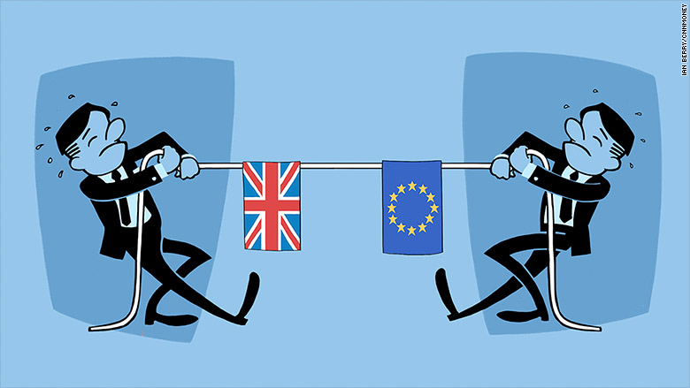
Brexit and Food
Summarising CIEH’s current policy position!
Tony Lewis
22 November 2017

Slide 2
The Hard Facts
UK ceases to be a member of the EU on 30 March 2019
45 years can’t be unravelled overnight
Profound implications for the environment, health and safety and food regulatory regimes in the UK
This presentation focuses on food as CIEH’s thinking in this area is quite well developed

Slide 3
EU Level Functions
Risk assessment undertaken by EFSA
Risk management decisions taken by European Commission and Council
Assurance on food safety compliance within EU and food safety regimes of countries who want to export to Europe carried out by Commission audits
Key systems for providing rapid warning of food safety threats, sharing information on crime and for notifying and tracking food from outside EU maintained by the Commission

Slide 4

Maintaining Trust a Key Priority
UK has some of the safest food in the world
Need to maintain public confidence in food and food safety systems
Need to be able to provide trading partners with confidence in the effectiveness of UK food regulation

Slide 5

Still At First Base
No agreement yet on any key issues
  Reciprocal rights of EU and UK citizens
  The island of Ireland
  Final divorce bill
Hard Brexit would be an environmental health disaster – at least in the short term

Slide 6
An opening ‘caveat’!
No detail on Her Majesty’s Government’s (HMG) approach to Brexit and post-Brexit policies in respect of food issues
Difficult to articulate risks and opportunities in a vacuum
Environmental public health risks to the UK and its citizens around the issue of trade and food are crystallising

Slide 7
This presentation….
This presentation summarises CIEH’s position on food and trade in food
Material contained in this presentation forms the basis of the CIEH submission to the House of Commons Select Committee on Environment, Food and Rural Affairs Inquiry into Food and Trade http://www.cieh.org/WorkArea/DownloadAsset.aspx?id=62976
CIEH’s submission was compiled by
  Members of the CIEH Food Advisory Board using data from members and outcomes from a joint workshop organised by CIEH and SUSTAIN

Slide 8

The Cliff-Edge
Uncertainty about the implications of moving to WTO rules
Likely to take years to renegotiate WTA schedules
Requires unanimous agreement of all 162 WTA signatories
Uncertainty – never been done before!
Extensive changes for the food industry, standards, science and research capability and for UK food inspection arrangements – principally via RoF
UK consumers may have to accept food that does not meet current expectations, in terms of quality, composition, hygiene and standards of production

Slide 9

Dealing with ‘a deal’
Changes and additional responsibilities will come at a difficult time
  UK standards and inspection bodies under pressure as a result of austerity
Food regulation professionals have very limited capacity to adapt to the scale of change without additional resources
Additional challenges face food exporters to EU countries depending upon the type of deal that is achieved:
  A deal where there are harmonised controls will see trade across a single border
  Audits by EU bodies (such as DG Sante) will still be necessary and acceptance of EU standards will still require systems to be in place to ensure these are complied with.

Slide 10
Dealing with ‘a deal’
A deal where we effectively become a “third country” will mean having to comply with all current EU standards, still be subject to EU audits and to have a health certification system in place. This is an area where lack of resources in available certifying staff (Port Health) may become an issue
The consequences of any food scares or incidents may lead the EU to pose emergency controls upon the UK with increased costs for compliance, potential rejected consignments, damage to reputations and delays in clearance

Slide 11
Dealing with a deal
CIEH takes the view that the role of Environmental Health Practitioners (EHP’s) must be recognised as the competent professionals to deliver Food Safety controls
CIEH believes that the means must be found to train and designate EHP’s to take on the relevant animal health certification role
However, recent data released by the Food Standards Agency shows that there are 50% fewer local authority staff delivering food advisory and regulatory activity in England than there are in Wales or Northern Ireland
  CIEH is concerned that this resource gap, together with the need for new arrangements to inspect and approve imported food at the ports will cause significant portside delays that may be too long to make trade viable for foods with a few days shelf life

Slide 12
Dealing with a deal
CIEH believes that wider workforce issues will also present a significant challenge to the food industry post Brexit.
  Uncertainty as to whether the UK will continue to have access to EU workers, including those who work as Environmental Health professionals in the food regulatory sector
In all trade scenarios, CIEH takes the view that the UK staying as close as possible to EU food standards, systems and institutions will be an advantage and opportunity – for consumers, for taxpayers and for the food industry.

Slide 13
Dealing with a deal
CIEH believes that EU (Withdrawal) Bill should pave the way for transparent, accountable and food-sensitive regulation that preserves and renews the UK’s high food standards.
CIEH considers it imperative that the Repeal Bill:
  Ensures that changes to legislation are open to full Parliamentary scrutiny
  Prioritises adequate protection and promotion of public health, food safety, food standards, environmental protection, working conditions and consumer rights
  Reinstates into UK law the precautionary principle
A further opportunity will be for the UK to establish a new Food Act that clearly sets out the UK’s vision for better food, farming and fishing, helping to frame current and future decision-making

Slide 14
Dealing with a deal
Working within the EU, the UK has developed its approaches to food safety and standards, consumer protection, workers’ rights, policing of food fraud, and much more
As the EU is unlikely to rapidly align with globally agreed (Codex) standards in a short space of time, the UK Government will be left with decisions to make on which standards to apply in order to trade most effectively - Codex or EU
The UK could have different standards in play for different markets following other international models e.g. the US ‘non-hormone treated cattle program’ that meets EU import requirements in a segregated supply chain

Slide 15
Dealing with a deal
The CIEH view is that the Government should ensure that all standards applied post Brexit are based on the best scientific evidence and risk assessment in order to afford the UK population and trading partners assurance of high levels of protection
The UK’s regained sovereignty could also be used as a transformational opportunity for the UK to show global leadership by adopting policies that set us on a path towards an increasingly sustainable food future

Slide 16
Dealing with a deal
CIEH encourages HMG to set out a vision for what they seek to achieve through new and existing trading arrangements, particularly in relation to food
We view the apparent desire to accelerate the move towards de-regulation and privatisation as disastrous for public confidence
In food, good independent regulation is vital for safety, public health, quality and consumer confidence and a race to agree trade deals only on the basis of reducing food prices is likely to be counter-productive
The Government must also consider factors such as animal health and welfare, consumer safety, workplace safety, environmental protection and agri-food chain employee incomes

Slide 17
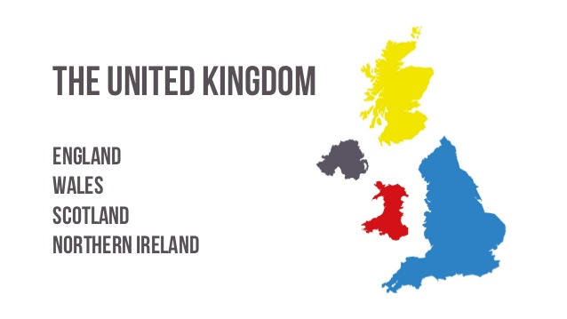
The devolution question
Devolution of key powers from Westminster to Scotland, Wales and Northern Ireland presents particular challenges
Food safety is a matter that is devolved to all the respective administrations
Neither the Westminster Government nor the FSA can unilaterally make decisions in respect of food standards and safety systems and processes; it must secure the agreement of the devolved administrations

Slide 18
The devolution question
In Ireland, the Good Friday Agreement (1998) is the foundation of the current peace process
It sets out a complex and unique series of provisions and establishes a series of co-operative institutions relating to a number of areas including:
The provisions within the Good Friday Agreement gives the Republic of Ireland (ROI) a say in matters relating to Northern Ireland that have an impact in ROI.
  This includes any system of food control that is not developed within the context of EU membership

Slide 19
Summarising where we are
Some visionary thinking and policy moves needed!
Serious investment in standards, infrastructure and inspection necessary to make border controls and port health arrangements as effective and frictionless as possible
CIEH believes that HMG should plan to deal clearly and holistically with governance, food standards, food security and trade issues
CIEH encourages HMG to develop a proper food policy and to ensure that all forthcoming policy and legislation should contribute towards achieving that vision

Slide 20
What we’re doing………
Lobbying Parliamentarians on behalf of EH and the work we do in food
  Promoting key amendments to the Withdrawal Bill in conjunction with APHA – promoting the importance of port health and key standards
  Specific ongoing dialogue with the Shadow Minister of State for DEFRA
  Working with CIEH Food Advisory Board members to produce a series of public-facing, factual information sheets covering the impact of Brexit on UK food policy
  Invited FSA to speak about their preparations for Brexit at Wales regional seminar on 29 November
  Engaging with FSAI on issues of mutual concern

Slide 21
Tony Lewis
Head of Policy, CIEH
t.lewis@cieh.org
Tel: 0207 827 5907
Kate Thompson
CIEH Director for Wales
k.thompson@cieh.org
Tel: 01633 865533

